Slide 1
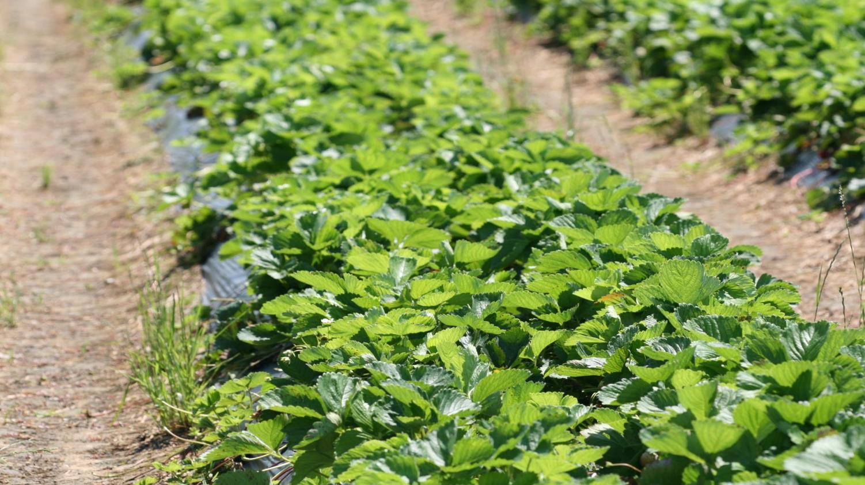

Strawberry pre plant meetings, 2020
Pest management considerations
Pollination biology
Hannah Burrack, Professor & Extension Specialist
Jeremy Slone, PhD Graduate
Laura Kraft, PhD Student
Department of Entomology & Plant Pathology

Slide 2
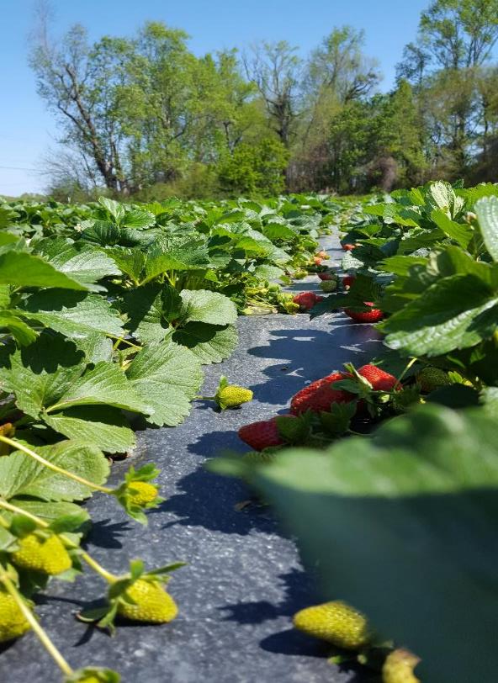
Topics
Pest management considerations
  Spider mite management
  SWD significance and control

Slide 3
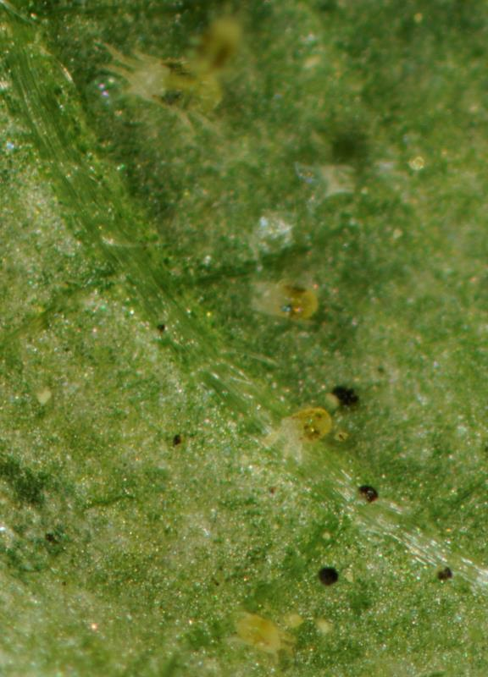
Spider mite control basics
Start scouting in early spring, when daytime temperatures start exceeding 50F
Treat is populations greater than 5 mites/leaflet are present pre fruiting
Avoid pyrethroid insecticides when mites are present
If using predatory mites, do not use oils or soaps for spider mite control post predator release

Slide 4
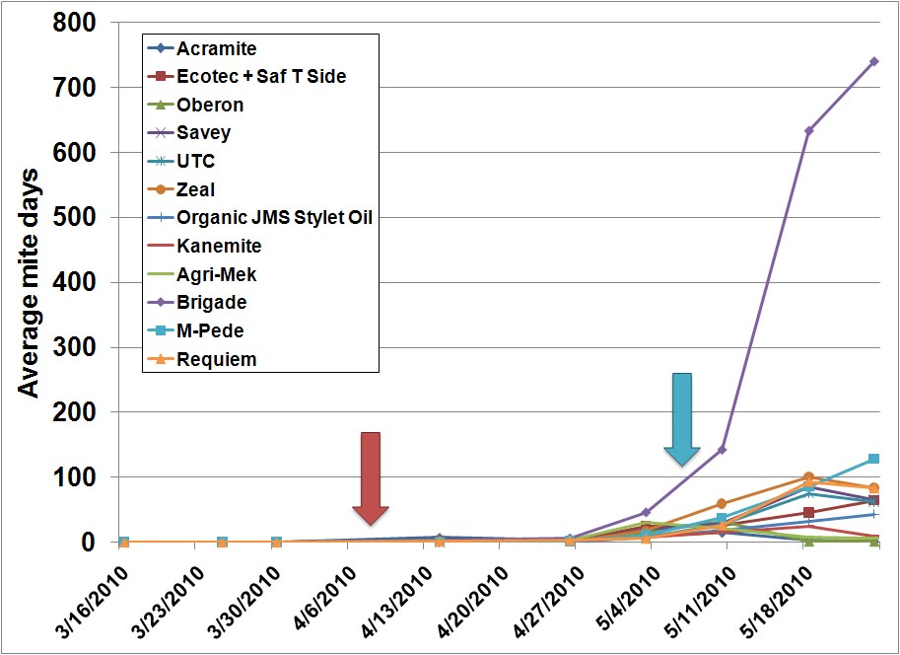
Spider mite control basics
Start scouting in early spring, when daytime temperatures start exceeding 50F
Treat is populations greater than 5 mites/leaflet are present pre fruiting
Avoid pyrethroid insecticides when mites are present
If using predatory mites, do not use oils or soaps for spider mite control post predator release

Slide 5
Conventional spider mite control options
Material | IRAC Group | Target life stage | Efficacy Rating (1-4)
Agri-Mek | 6 | Motiles | 3
Savey | 10A | Immatures | 3
Zeal | 10B | Immatures | 3
Acramite | 20D | Motiles, some egg | 4
Vendex | 12B | Motiles | 2
Kanemite | 20B | Motiles, some egg | 4
Oberon | 23 | Immatures, some adult | 4
Portal | 21A | Motiles | 3
Nealta | 25 | All stages | 4

Slide 6
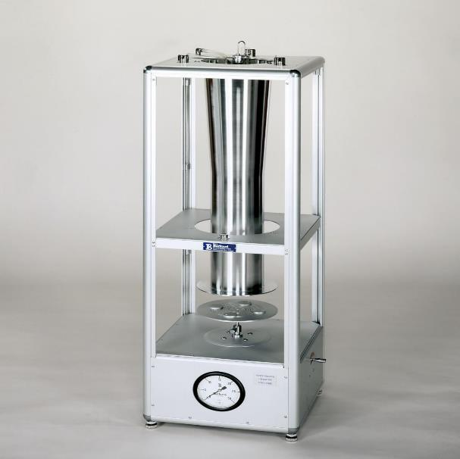
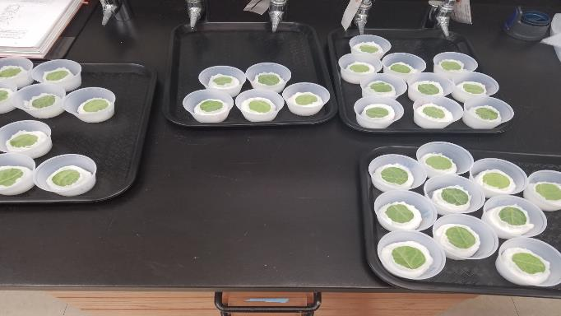
Screening spider mites for resistance

Slide 7
Screening spider mites for resistance – NC Populations
**
*
*
*
**
**
**
**
*
*
*No different than control
**Better than control, but weaker than other materials
Greater variability among adulticides. Brigade and Vendex ineffective.

Slide 8

Screening spider mites for resistance – SC Populations
Paul Bergeron & Rebecca Schmid-Jeffris (USDA ARS)

Slide 9
Screening spider mites for resistance – SC Populations
Adulticides
Paul Bergeron & Rebecca Schmid-Jeffris (USDA ARS)

Slide 10
Screening spider mites for resistance – SC Populations
Ovicides
Paul Bergeron & Rebecca Schmid-Jeffris (USDA ARS)

Slide 11
Screening spider mites for resistance – SC Populations
Paul Bergeron & Rebecca Schmid-Jeffris (USDA ARS)

Slide 12




Acknowledgements
Jim Walgenbach
Paul Bergeron & Rebecca Schmid-Jeffris (USDA ARS)

Slide 13
Spider mite control basics
Start scouting in early spring, when daytime temperatures start exceeding 50F
Treat is populations greater than 5 mites/leaflet are present pre fruiting
Avoid pyrethroid insecticides when mites are present
If using predatory mites, do not use oils or soaps for spider mite control post predator release

Slide 14
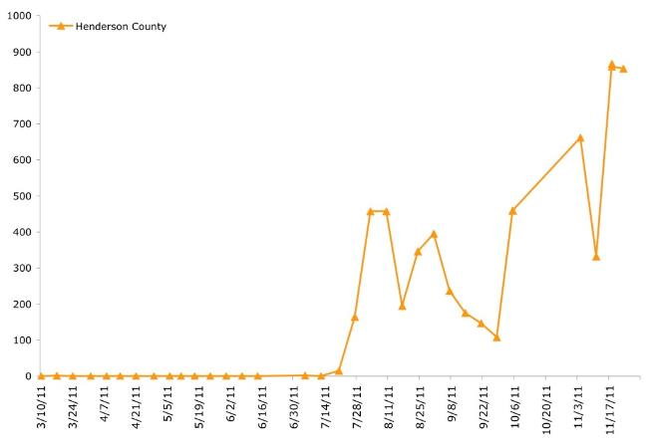



SWD in strawberries
Spotted wing drosophila (SWD) is not a consistent pest in spring-fruiting strawberries
Fall fruiting berries are at high risk
In most years, the small infestation present can be managed through cultural control
Western North Carolina, 2011
Total SWD per week

Slide 15
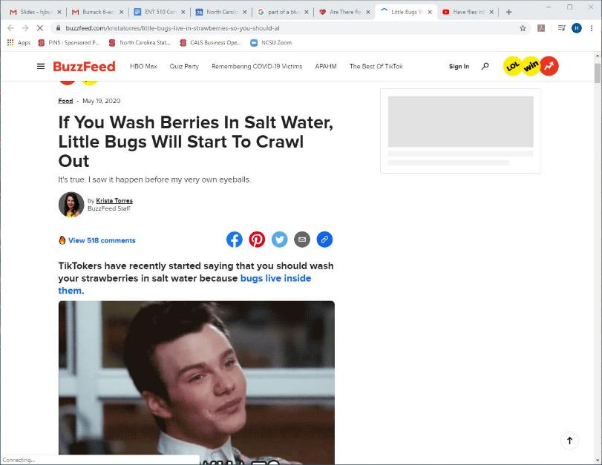
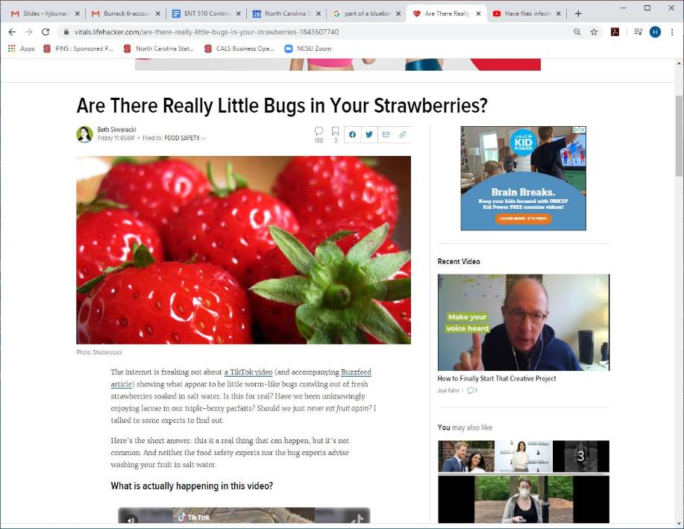
SWD in strawberries – May be a post harvest concern

Slide 16
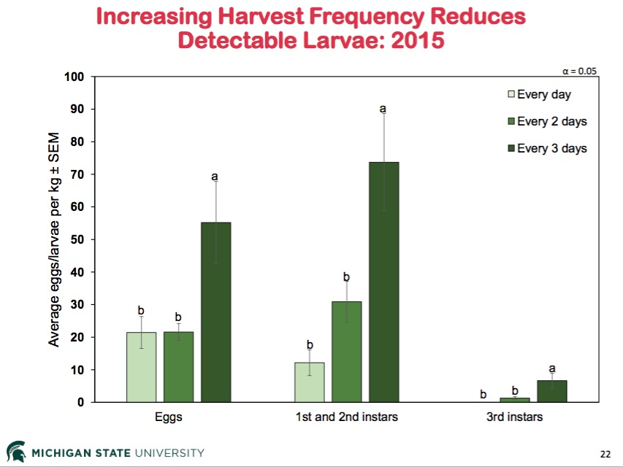

Slide 17
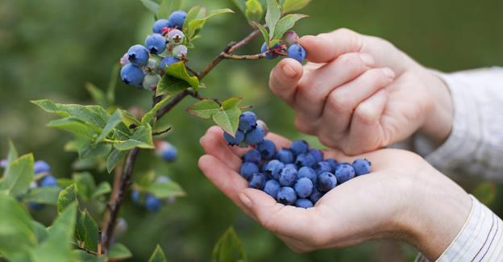
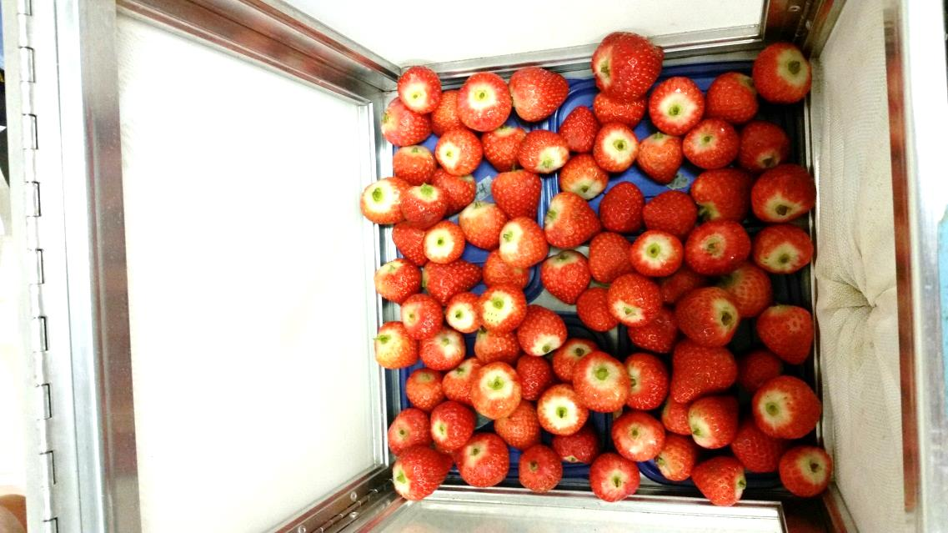
Two types of studies
Field-Infested Fruit
Laboratory-Infested Fruit

Slide 18
df=6,18; F=9.70; p<0.0001
b
a

Slide 19
Laboratory-Infested Strawberry
Egg
1st Instar
Mean D. suzukii
2nd Instar
3rd Instar

Slide 20

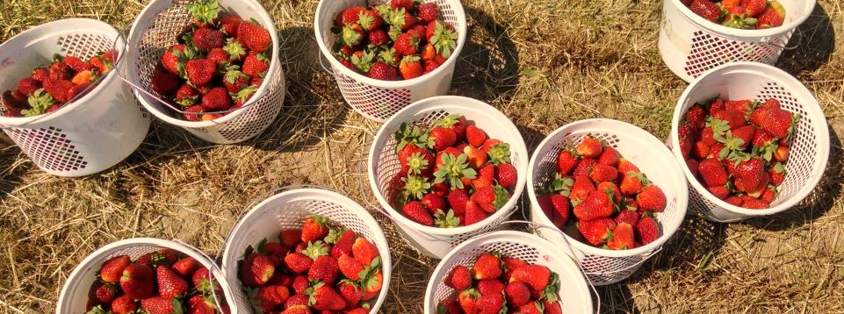
Read us @ entomology.ces.ncsu.edu
Like us @ facebook.com/NCSmallFruitIPM
Follow us @NCSmallFruitIPM

