Slide 1



Communication: Game On!
Lesson 6
Powerful Public Speaking
Georgia 4-H English Language Arts Curriculum

Slide 2
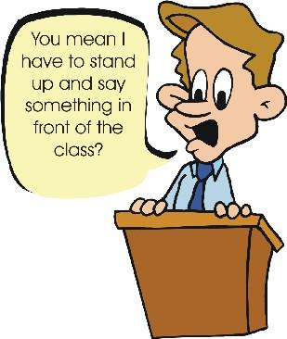
…is defined as the process of speaking to a group of people in a structured, deliberate manner intended to inform, influence, or entertain the listeners
Public Speaking
Notes:
Who can tell me what public speaking is?
What is communication? What types/styles of public speaking are there?
Why is public speaking so scary? Why do people not want to stand up and talk in front of other?
Let students discuss
Click for definition

Slide 3
Not Me!

Slide 4

Public Speaking Helps …
Increase your self confidence
Make you more comfortable in front of people
Fine tunes your everyday communication skills
Great way to make a good first impression

Slide 5





-Know your subject matter – pick something that you are really interested in.
Tips to Help You with Public Speaking…
-Know your speech- practice, practice, practice. In most cases it is fine to have to have notecards to refer to when you are delivering your speech.

Slide 6


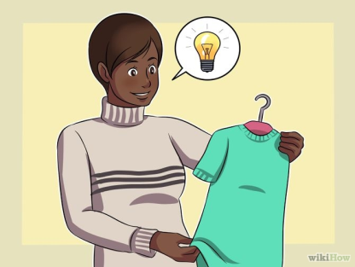
-Realize that your audience isn’t so special, remember that they are just as nervous as you or have been as nervous as you in the past.
-Get plenty of sleep the night before your speech.
-Lay your clothes out the night before your speech. Remember to dress for your audience.

Slide 7
-Take time to get settled and comfortable before the speech begins.
-Before you begin your speech, breathe! Look directly at your audience and don’t rush into your speech.
-Stand straight and use hand gestures only when you are making a point.

Slide 8
-Show energy and enthusiasm. If you are excited about your presentation then others will be excited too.
-Use facial expressions to draw your audience in.
-Stay focused on one thing – the subject of your speech.

Slide 9

-Remind yourself how great you really are with positive affirmations. “I am the best!” “My speech is great!” “I can do this!”
-The most important thing to remember is… be yourself and …

Slide 10
Game Time…

Slide 11

I am a Winner...
PowerPoint created by:
Angie Daughtry, 4-H Agent
University of Georgia Cooperative Extension
Candler County 4-H
1075 East Hiawatha Street Suite B
Metter, GA 30439
angie@uga.edu
at Public Speaking!!

Slide 12
References
Lesson Author:
Angie Daughtry
PowerPoint Developed by
Angie Daughtry
Candler County Extension Agent, 2014
PowerPoint Adapted by:
Abby Smith
Effingham County Extension Agent, 2015
Adapted from “Finding Your Way to Project Achievement” of the Friends magazines series, written by Jenny Jordan, 2013
Artwork from Friends Magazine created by Sam Pittary, UGA Printing

