Slide 1
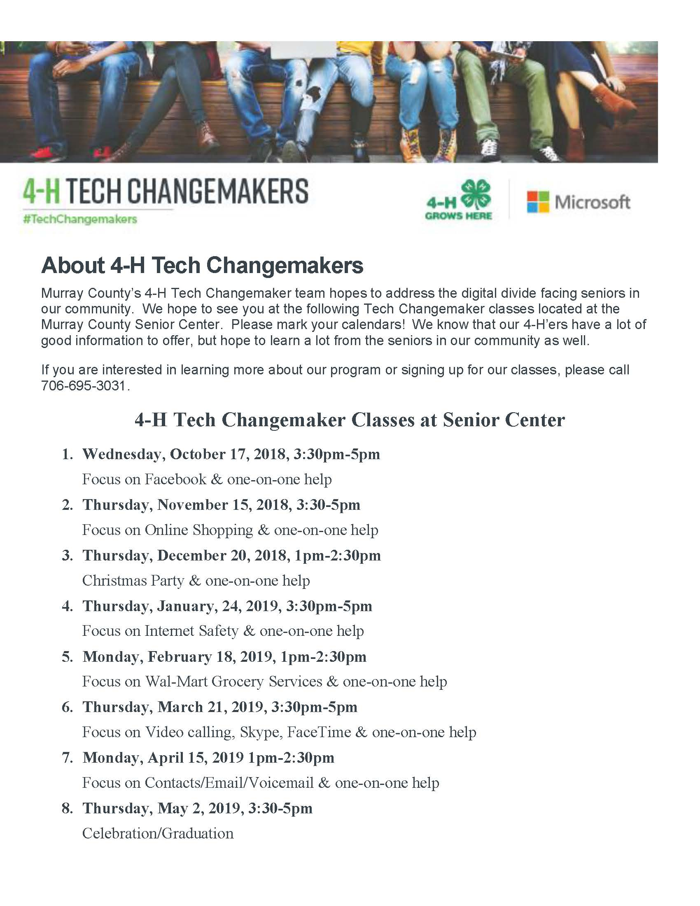
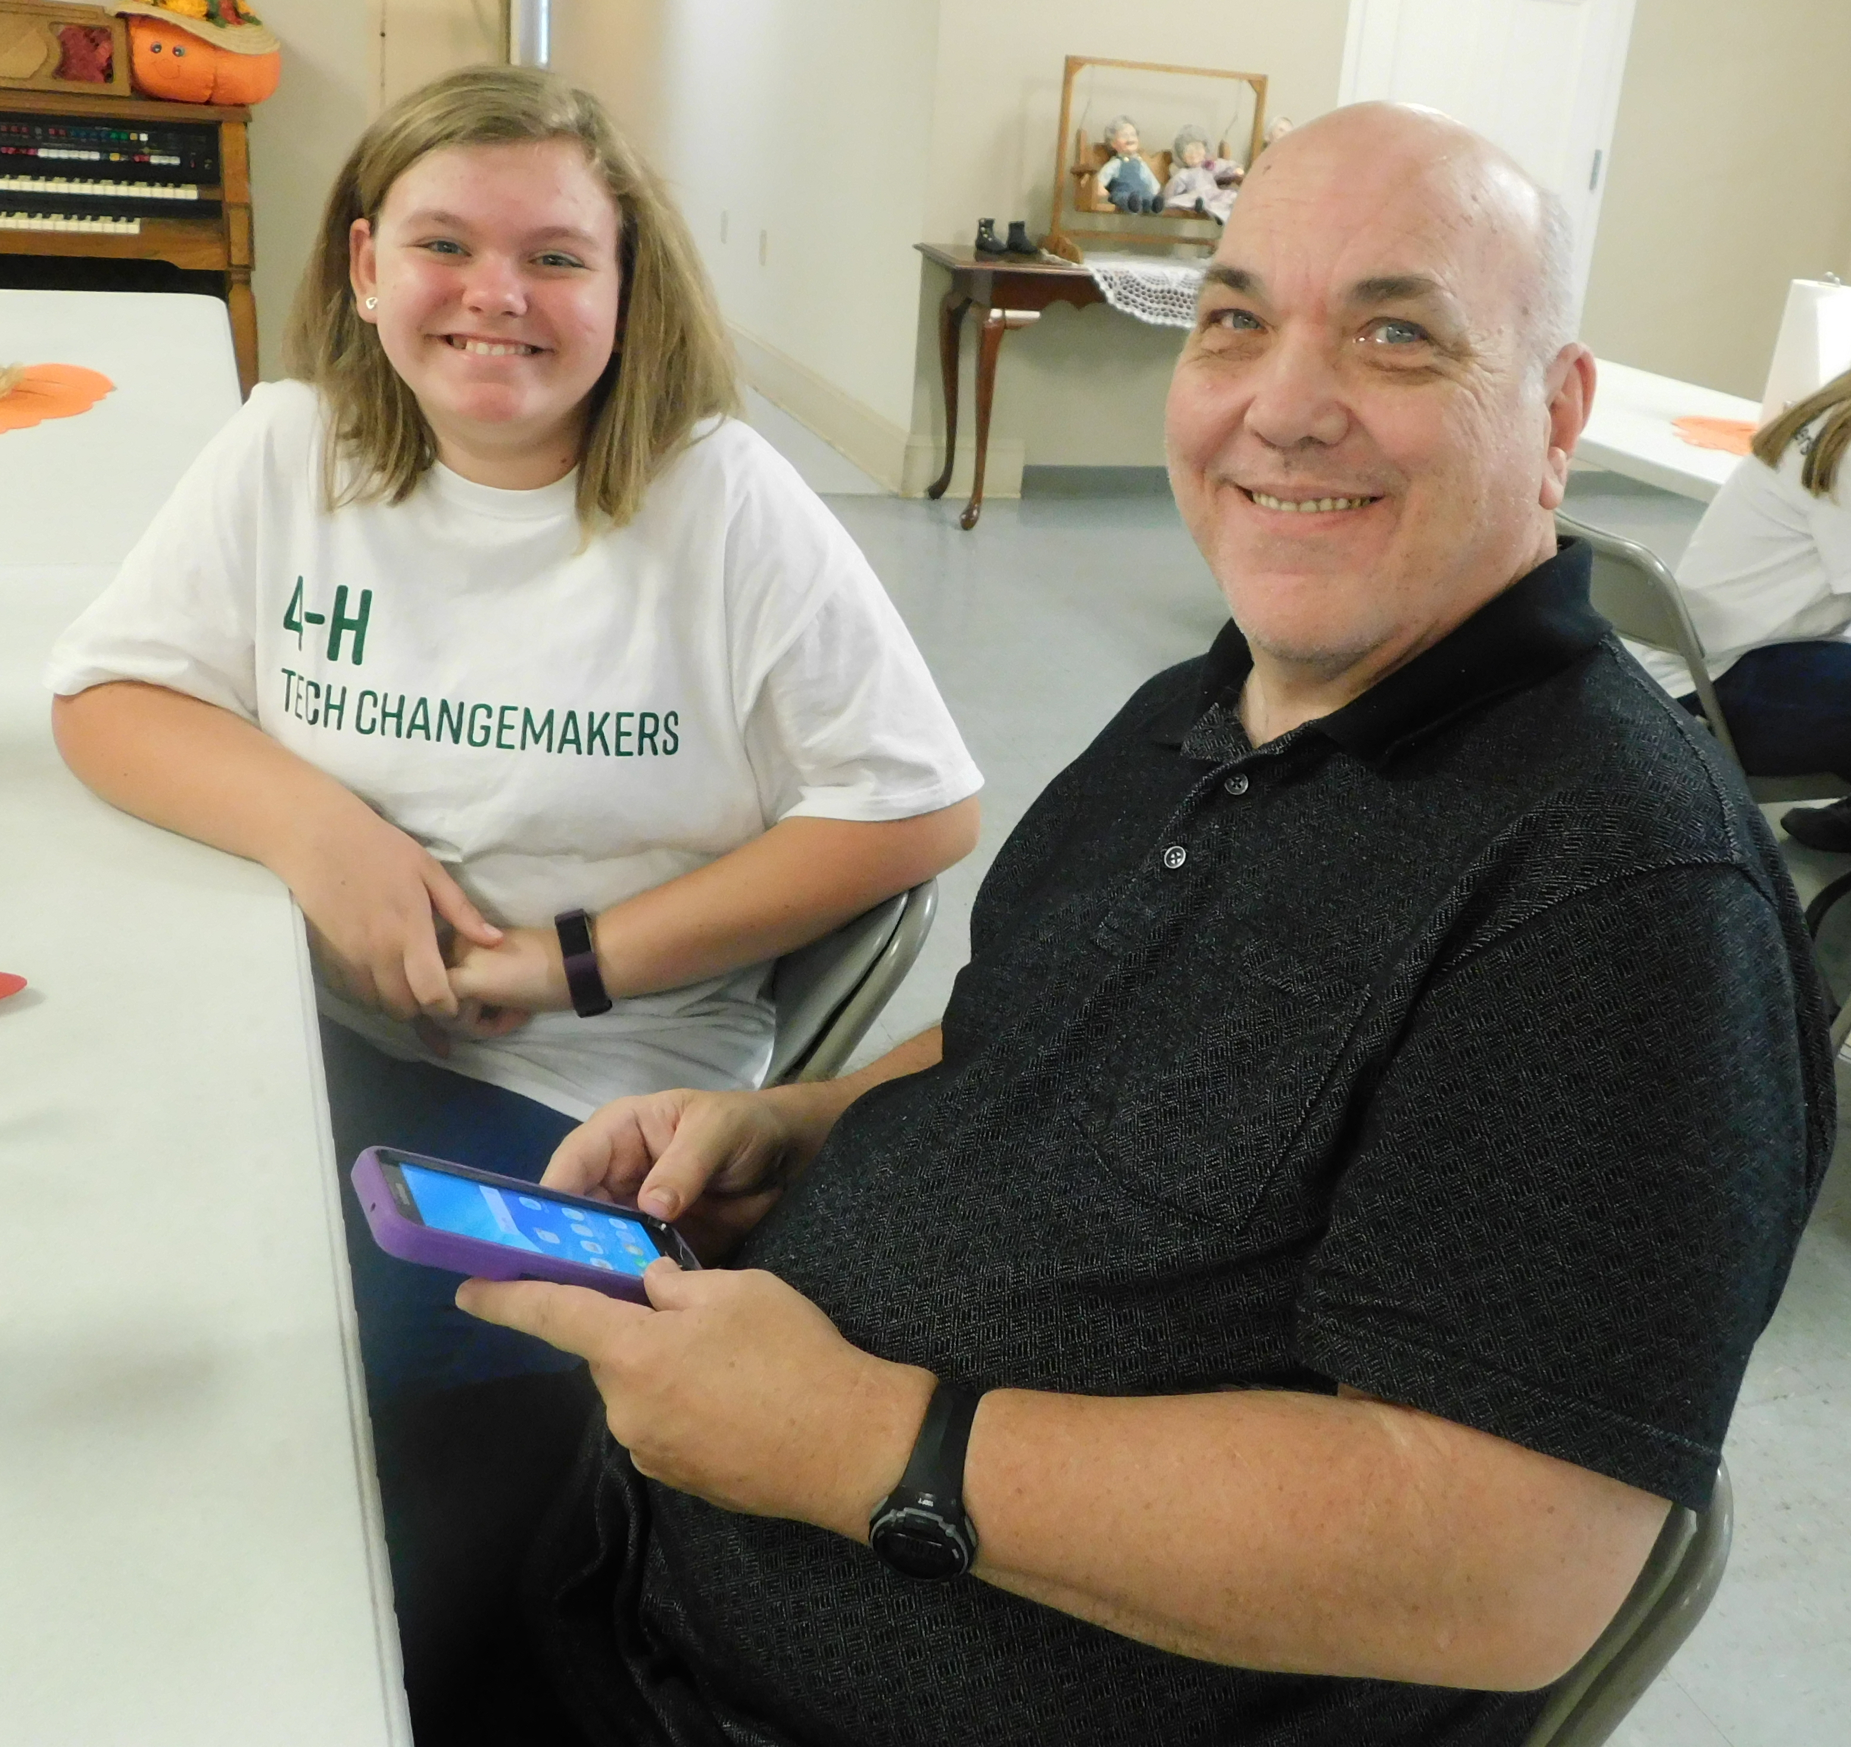
Program Delivery
By Stephanie Skojac, Alexandria Griner, Kandace Edwards, Caleb Millican, and Lori Bledsoe
In the summer of 2018, Murray County 4-H received a 4-H Tech Changemakers grant from the Microsoft Corporation in conjunction with National 4-H Council. The purpose of the grant was to allow a team of 4-H Youth Leaders to identify a need in their community and then address that need using technology. Led by Youth Leaders Daniel Skojac and Boaz Whealy, Murray County 4-H assembled a team of 4-H’ers and conducted a needs assessment in the community. Through surveying people young and old, it was found there was a big gap between the digital skills of senior citizens in Murray County and younger residents, and that there was interest in making classes available to senior citizens to improve their digital literacy skills. That need, combined with the skills of the 4-H’ers in Murray County, led the team to decide to address this issue by offering monthly classes to help seniors learn to use technologies they already had better, and also to introduce them to technologies or technological issues with which they may not already be familiar. Murray County 4-H Tech Changemaker leaders approached the director of the Murray County Senior Center with the idea, which became the beginning of a strong partnership.
One day each month, about 20-25 Murray County 4-H Tech Changemakers arrived at the senior center after school. Refreshments were provided and the team took 20-30 minutes to eat and socialize with each other and the individuals that have come for the monthly class. After they ate, a brief presentation was given about a focused topic. Topics focused on throughout the year included: Getting to Know Your Device, Facebook, Online Shopping, Internet Safety, Wal-Mart Grocery Services, video calling applications such as Skype and FaceTime, and using features such as Contacts and Voicemail on personal devices. After this time of focus, 4-H Tech Changemaker team members spread out and worked one-on-one with the seniors on any type of tech questions they may have. 4-H Tech Changemaker team members have helped with everything from sending and receiving text messages on flip phones and connecting loved ones through social media or email, to helping one woman figure out how to watch the Braves game online. Attendees brought their own personal devices for assistance if they had them, or through the generosity of Microsoft, Murray County 4-H Tech Changemakers was able to provide Microsoft Surface Pros for seniors to use during the classes. A core group of seniors became the “regulars,” and strong relationships formed between the youth and these individuals. Participation in this program helped the seniors with their digital skills and it helped the 4-H’ers become better teachers. 4-H Tech Changemakers were not only building a bridge across the digital divide, but a generational one as well.
2018-2019 Program Schedule
Introduction
Results
Next Steps
National 4-H Council and Microsoft are working together through the 4-H Tech Changemakers Program to help close the broadband access gap. Currently in the U.S. there are 24 million people who do not have access to high speed broadband internet and millions more lack the digital skills to use this important tool. The 4-H Tech Changemakers Program combines the power of teen leadership with the opportunities technology and broadband access offer to help communities realize the potential of technology as a force for good. This program will elevate teens as teachers to provide training in technology and digital literacy skills to assist adults in 80 communities across 13 states. Murray County 4-H trained youth to provide instruction and support to senior citizens on basic use of everyday technology. They offered support through community collaborations. Monthly classes are offered at the Murray County Senior Center focusing on digital literacy skills. Some of the classes focus on social media, online shopping, internet safety, video calling, grocery services, and basic skills involving email, contacts and voicemail. This program also improves leadership skills of 4-H’ers teaching digital literacy monthly to an audience of another generation.
Throughout the course of the program, Murray County 4-H had 30 youth leaders teaching sessions and served a total of 26 senior adults.
In a survey administered during the final session of the program, every adult respondent indicated that they agreed or strongly agreed with the following statements about the 4-H Tech Changemakers Program:
I learned new technology skills
This activity made me want to learn more about technology
In this activity, I learned ways technology can help me
The teens teaching were knowledgeable about the content for this activity.
Twenty-three youth Tech Changemakers also completed a post-survey regarding their experience. Results indicated the following:
96% agreed with the statements that the 4-H Tech Changemakers Project is a place where you get to teach others what you have learned and a place where you have a chance to be a leader
100% agreed or strongly agreed that the 4-H Tech Changemakers Project inspired them to help their community
100% agreed or strongly agreed that in the 4-H Tech Changemakers Project, they learned new technology skills
96% agreed or strongly agreed that the 4-H Tech Changemakers Project made them want to learn more about technology
100% agreed with the statement that in the 4-H Tech Changemakers Project, I see how technology can help change my community for the better
“Tech Changemakers isn’t just a program to learn more about technology, it’s a place that cultivates lasting bonds between senior citizens and youth alike.”
- Boaz, 4-H Tech Changemaker
Murray County is offering a second year of this program with a series of 8 workshops throughout the year at their local senior center. In addition, through Murray County 4-H’s strong leadership on this program, an additional grant was offered and the 4-H Tech Changemaker Program has now expanded to three additional counties in Northwest District. In March, five adults and seven youth traveled to Columbus, Ohio to be trained to deliver the 4-H Tech Changemaker Program. In April, those who received the national training hosted a tri-county teen leader workshop in which they trained 23 other 4-H’ers to be 4-H Tech Changemakers in their county. Workshops have begun in various locations throughout the three counties, including libraries, schools, and community centers.
"As you know I have been out of school for a while now and technology was not a word in existence at that time... These young leaders that we had teach us technology classes were not only kind and caring toward us but very patient with us…These students were excellent teachers and throughout the year they became our friends as well.”
- Betty Sue Grooms,
4-H Tech Changemaker Adult Participant
Above: Tri-county workshop that trained 23 additional youth to lead 4-H Microsoft Tech Changemakers sessions
Left: Teen leaders at 4-H Microsoft Tech Changemakers training in Columbus Ohio

