Slide 1
Something smells Fishy About This Art
GAE4-HA 2019
Ali merk

Slide 2
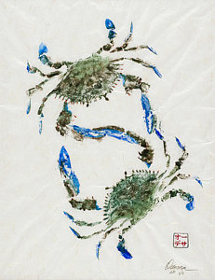
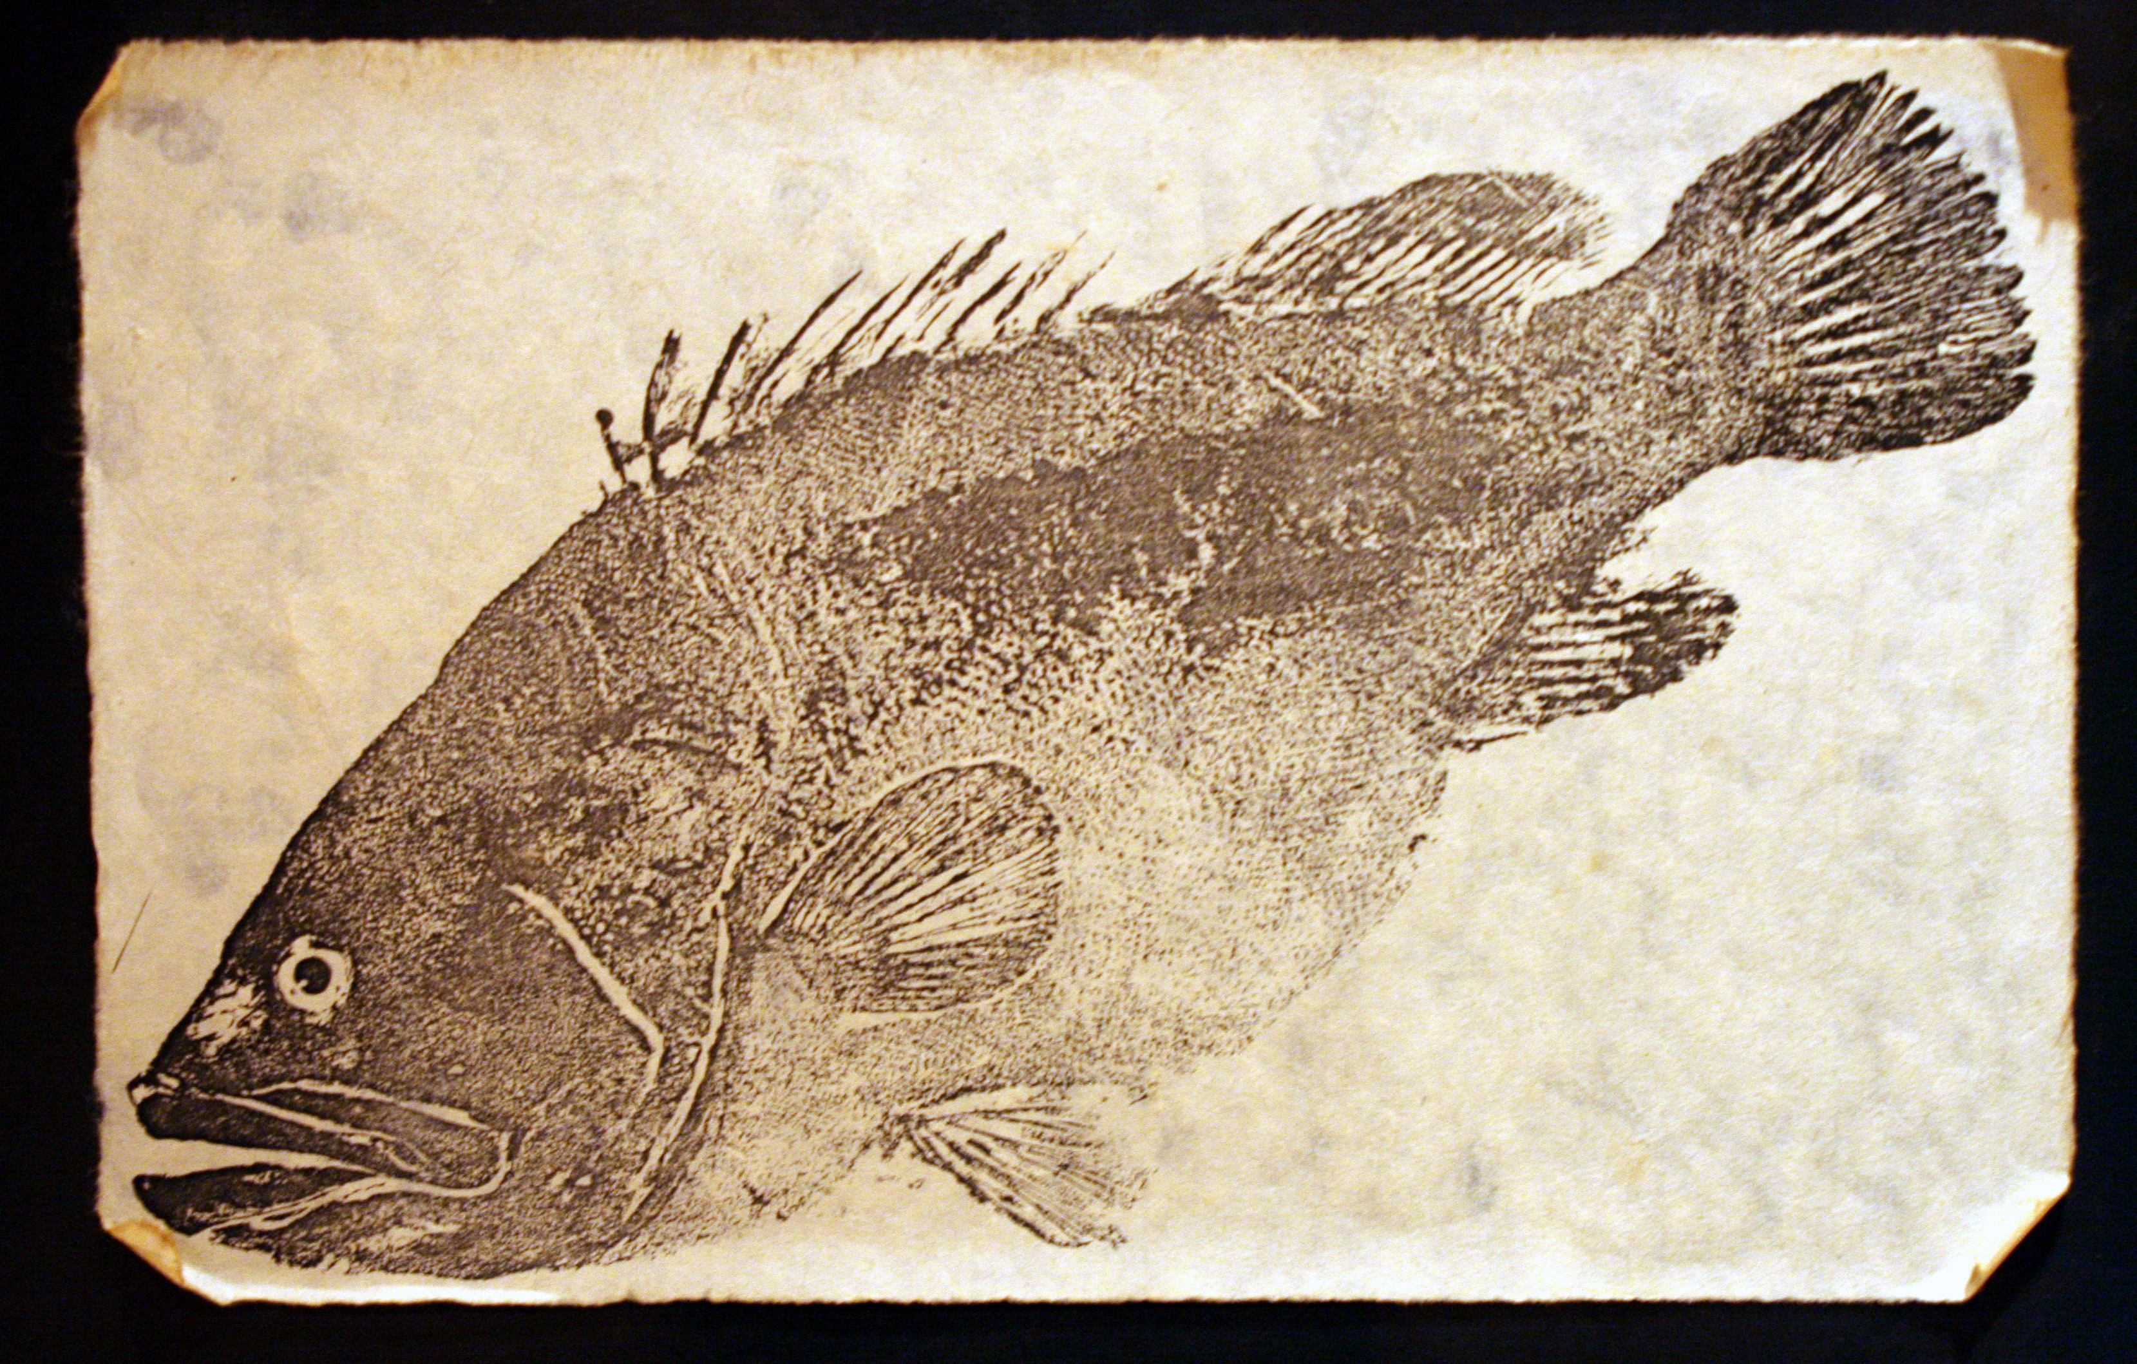
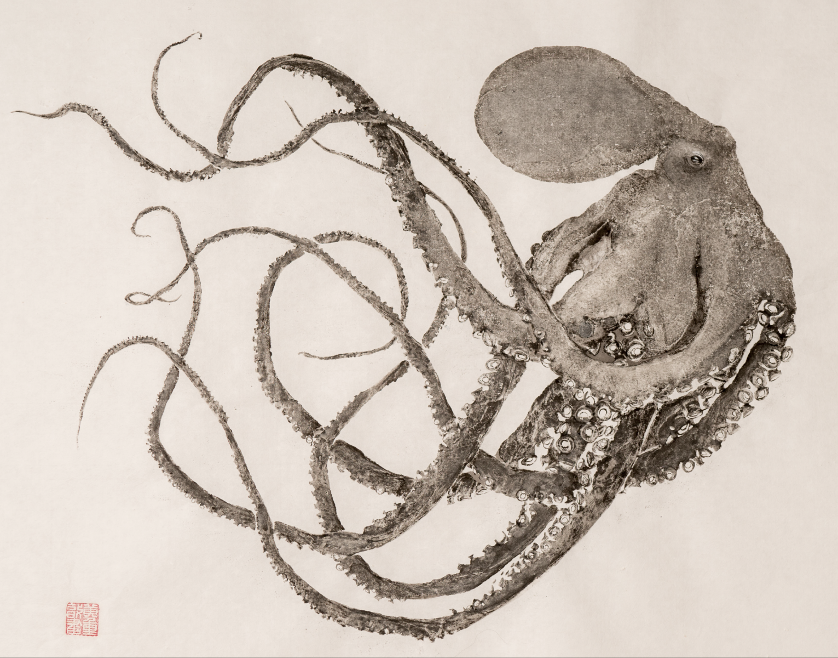
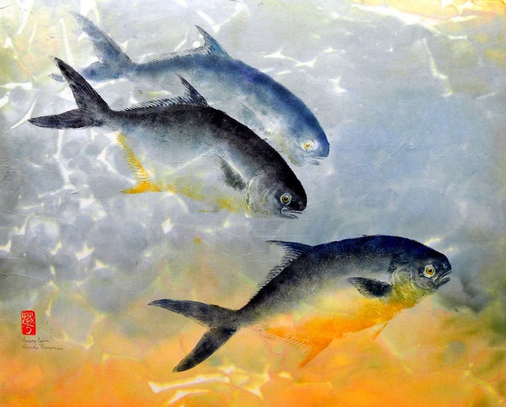
Gyotaku (Gee-oh-tak-oo)

Slide 3
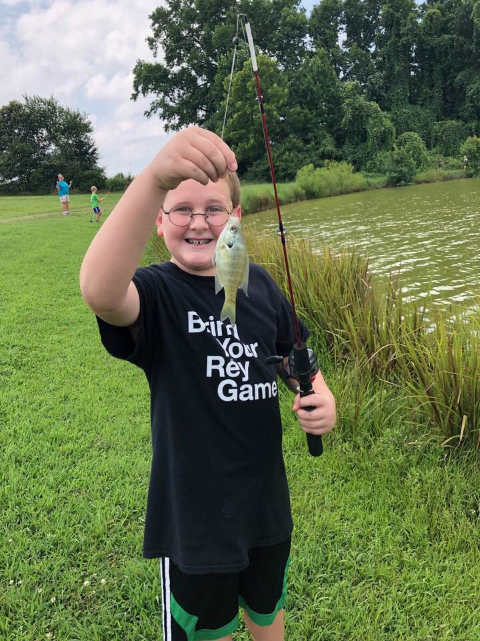
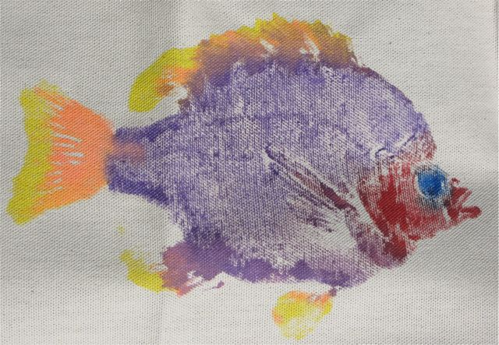
Gyotaku and 4-H?

Slide 4
Basics
Fish
Canvas
Paint

