Slide 1
Fruit For The Spirit
GAE4-HA 2019
Ali Merk

Slide 2
Things learned in these projects:
Sensory- visual and tactile
Geometry and fractions
Dopamine production
Satisfaction and accomplishment
Service and self
Inclusion- age, sex, social and economic

Slide 3
Expanded ideas:
Recycled material
Sentimental material
Mixed stages of production
Safety and mob control

Slide 4
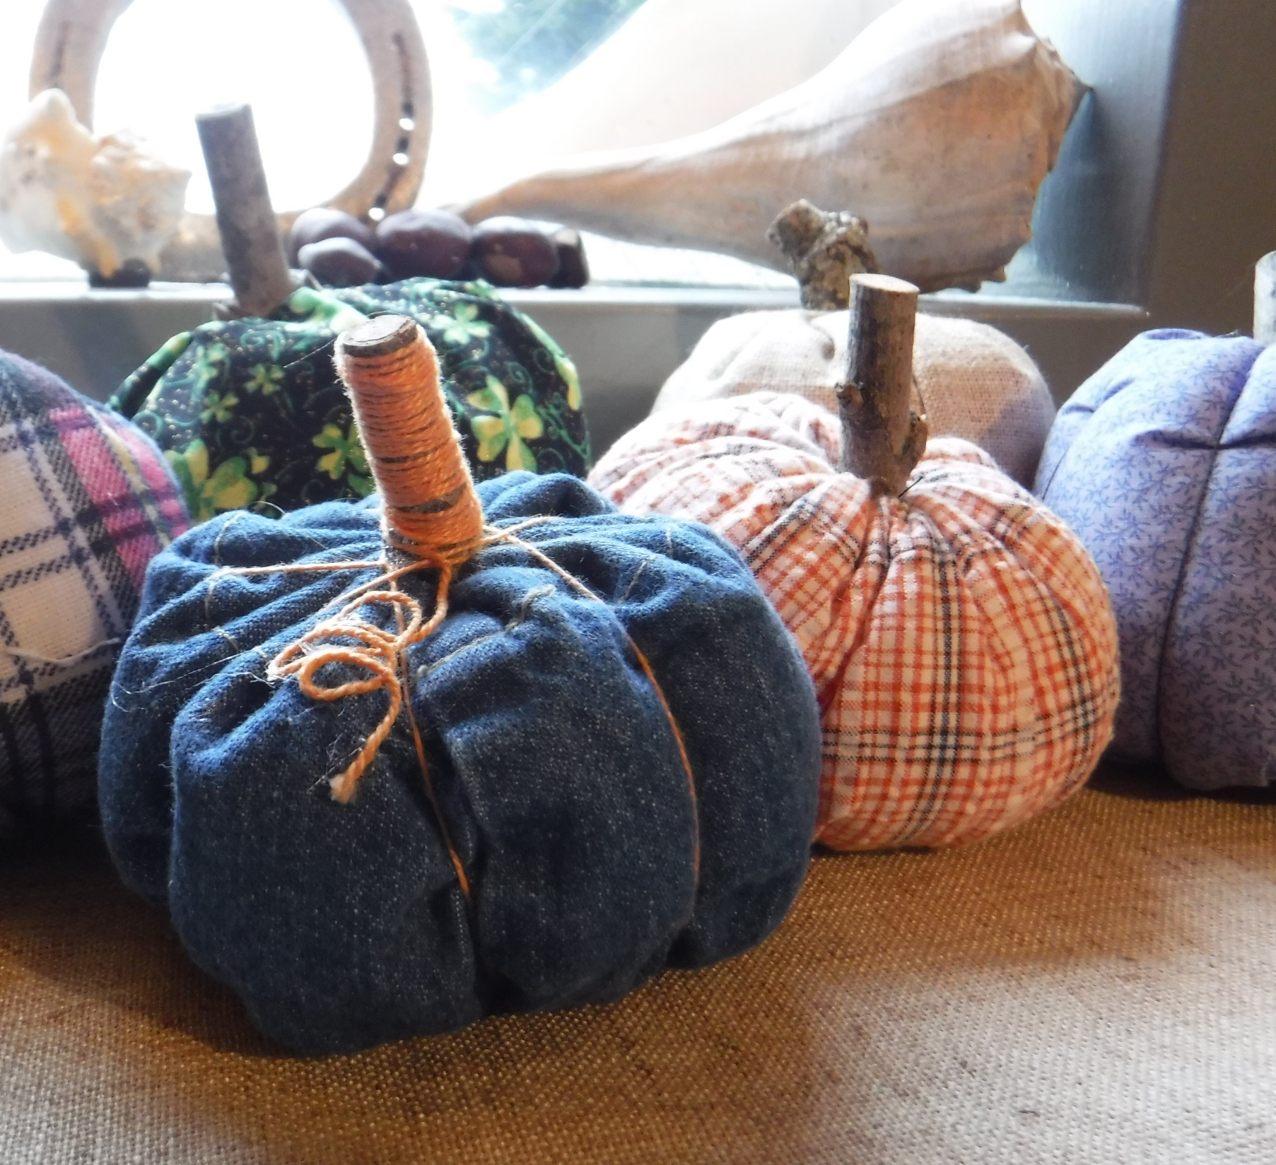
Fabric Pumpkins

Slide 5
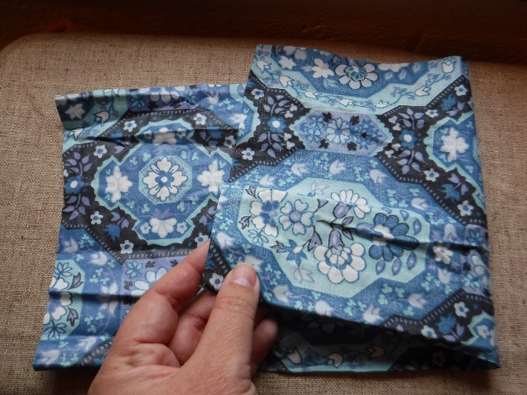
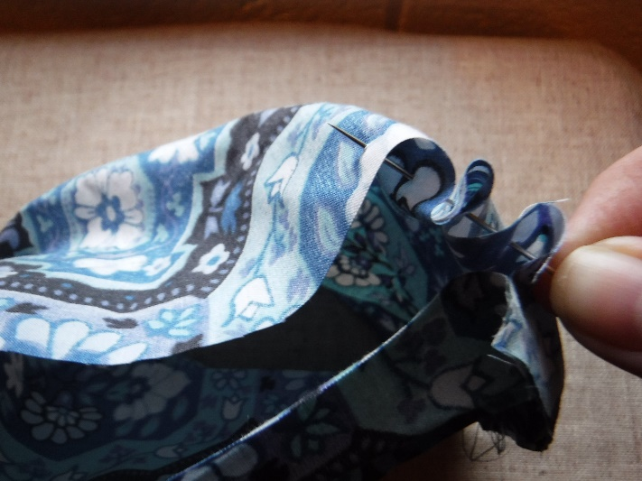
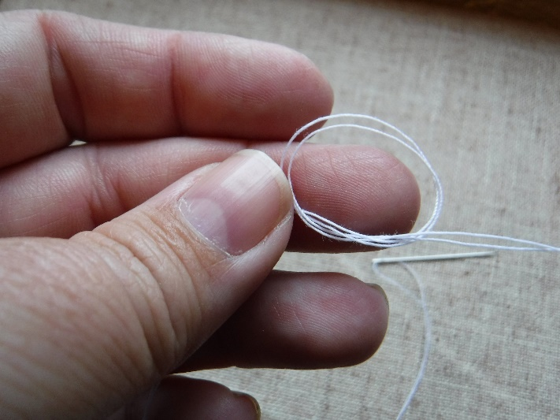
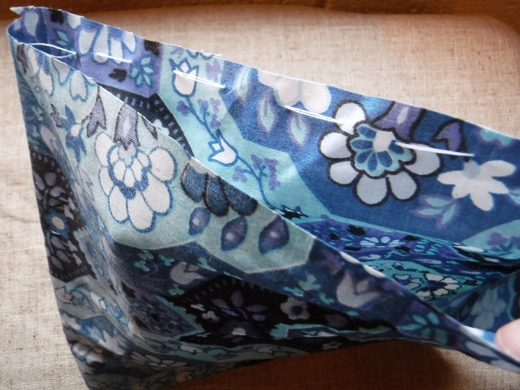
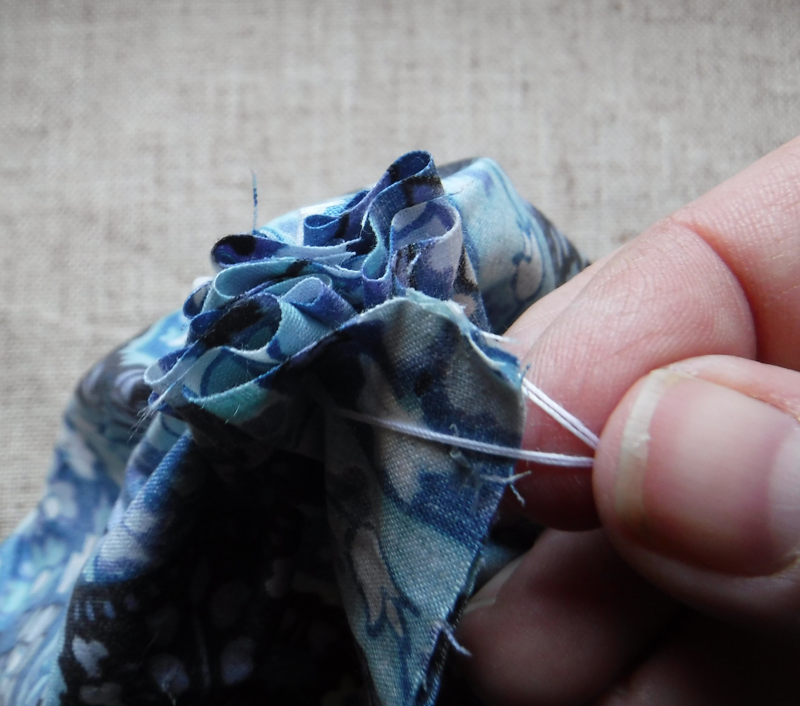
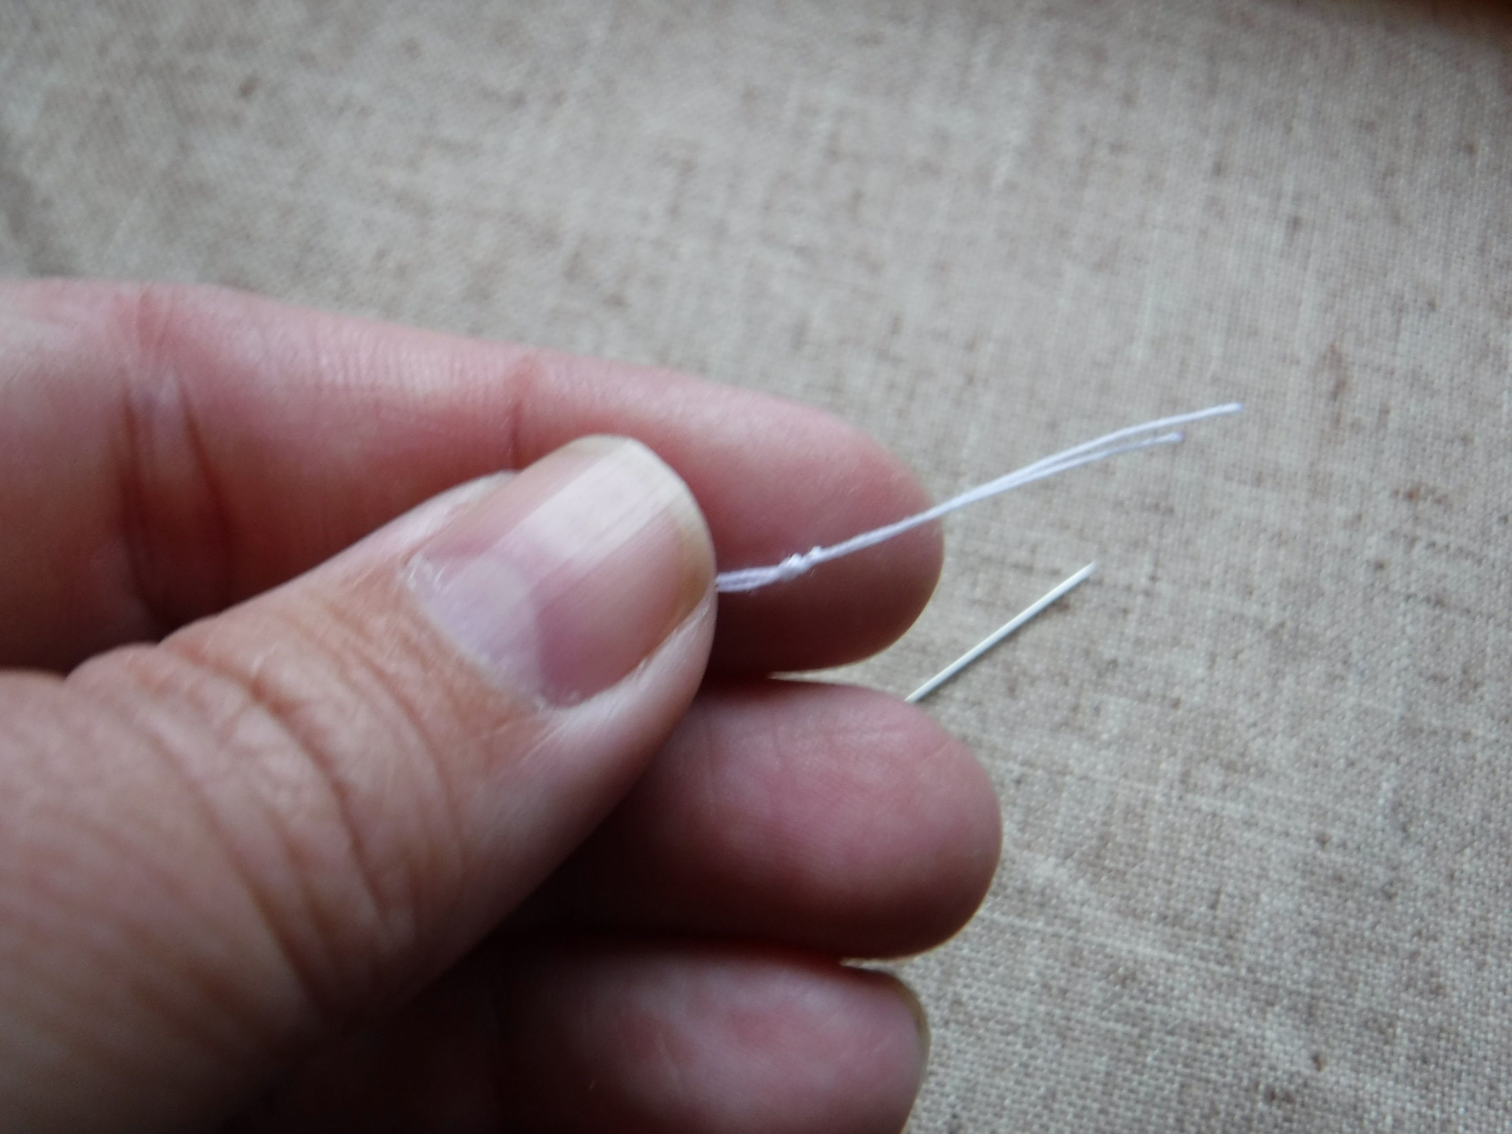
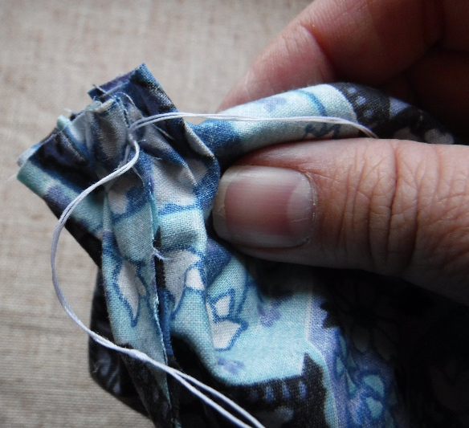
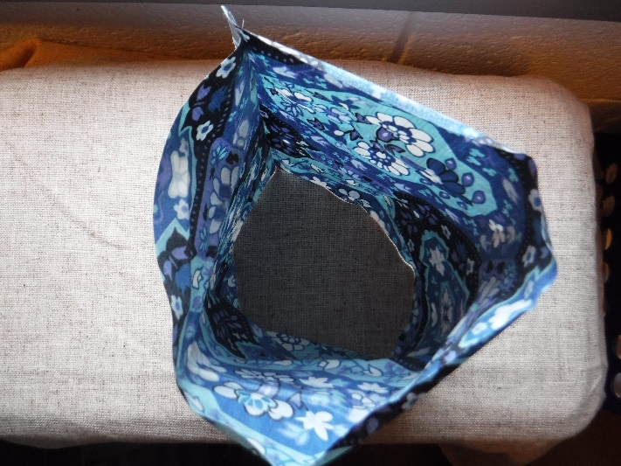
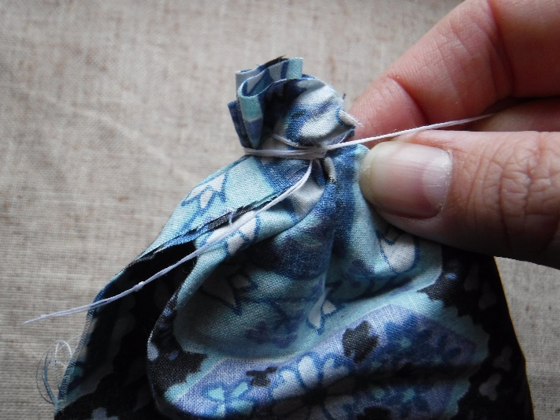
Cut rectangle of fabric; place right sides together and fold long side in half
Thread a needle with doubled thread and knot the end
Secure long end of rectangle together with glue, or stitches
4. Starting at side seam, sew long running stitch around the circumference of cylinder, close to the edge
5. Once stitches meet, pull the ends to gather the circle and secure with a double knot
6. Wrap the long end of the thread several times around the end, pull tight and secure with double knot

Slide 6
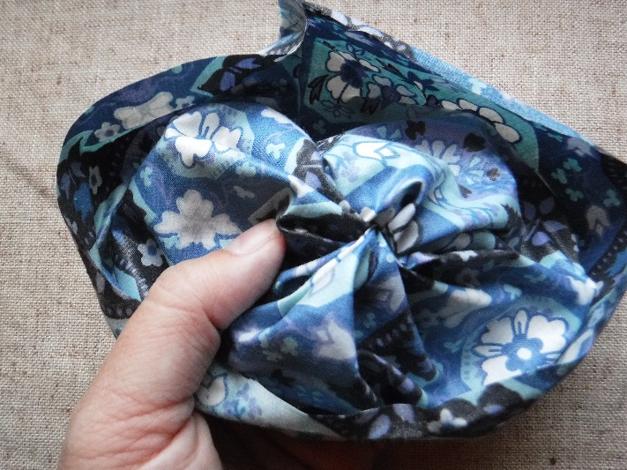
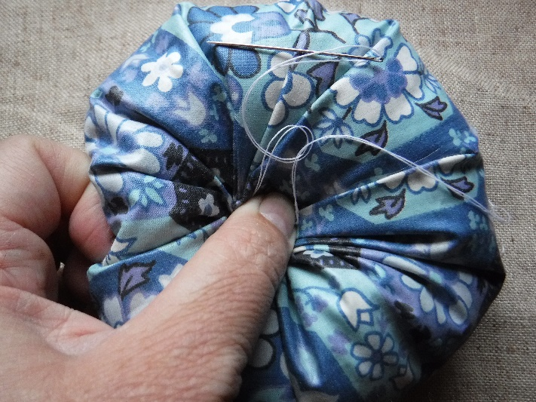
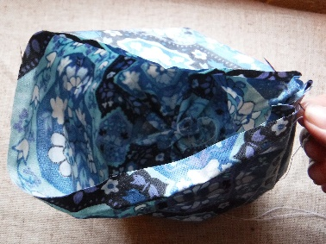
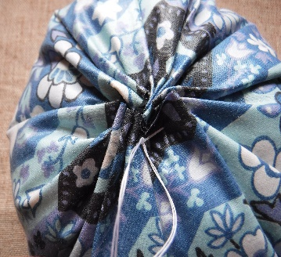
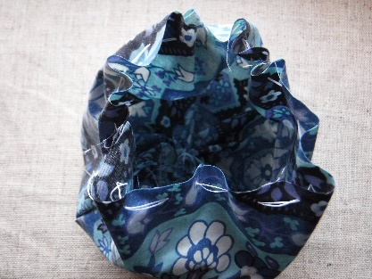
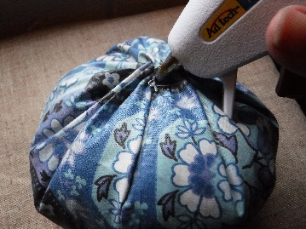
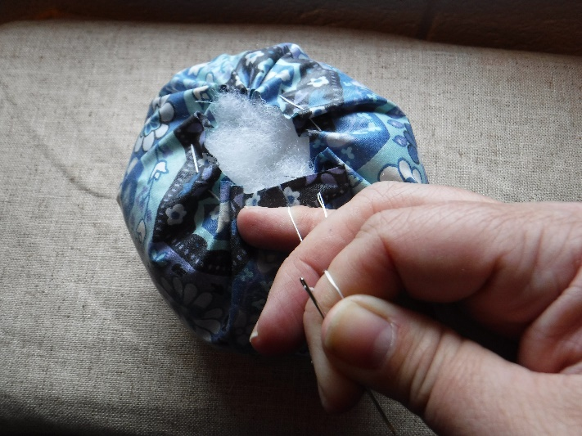
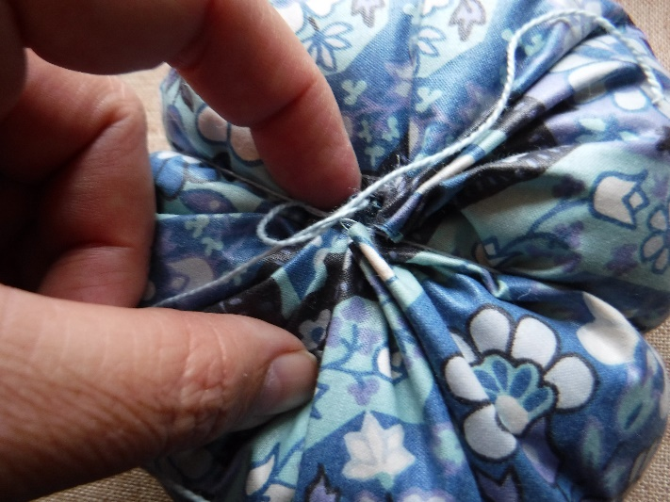
7. Flip right-side out
8. Repeat step 4. Running stitch around edge of cylinder
9. Fill with substrate; pull strings
10. Squishing down helps to hold a tight gather; secure with a double knot
11. Trim threads and insure hold with a drop of glue
12. If segments are desired, tie string around pumpkin; pull tight and tie knot on end of string- leaving long tail for more segments

Slide 7
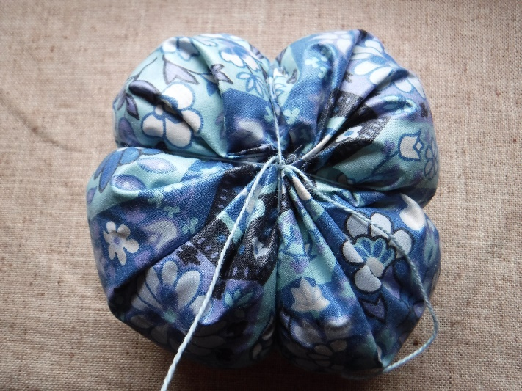
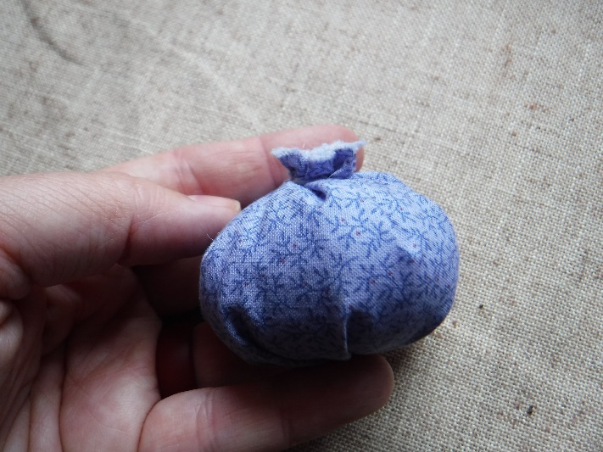
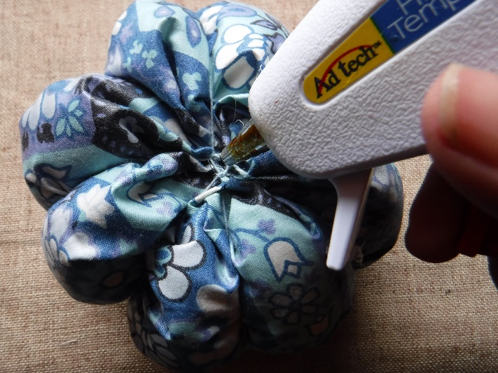
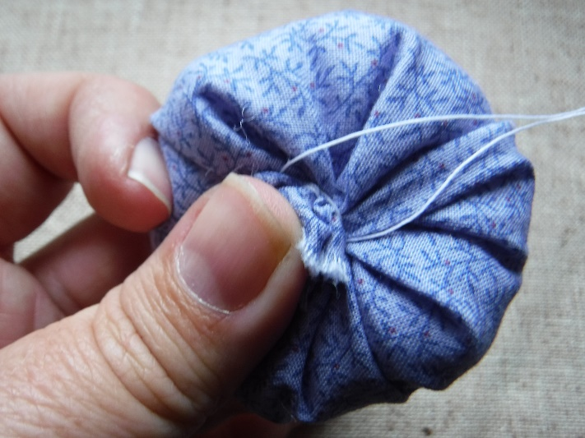
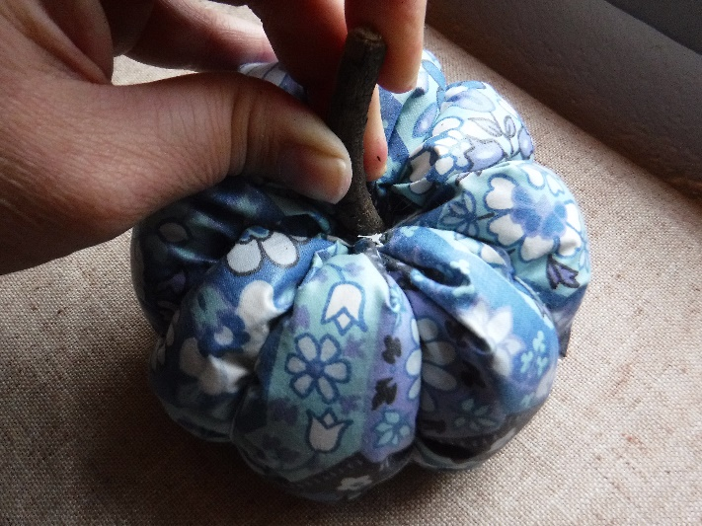
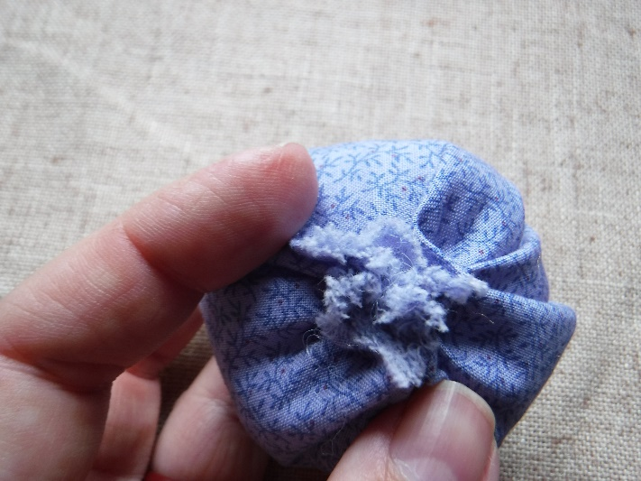
13. With each segment secure with knot at the bottom ‘belly button’; 8 segments (4 strings) is best
14. After arranging strings to desired place, trim strings and insure hold with drop of glue
15. Flip pumpkin over and glue twig stem; squishing down for several minutes while hot glue dries gives best look
PATTERN BONUS
Fabric Blueberries
1. Repeat steps 1-11 of pumpkin pattern- with the adjustment of leaving a little more edge on second round of running stitch
2. It may take a little preening of gathered edge to get the blueberry look

Slide 8
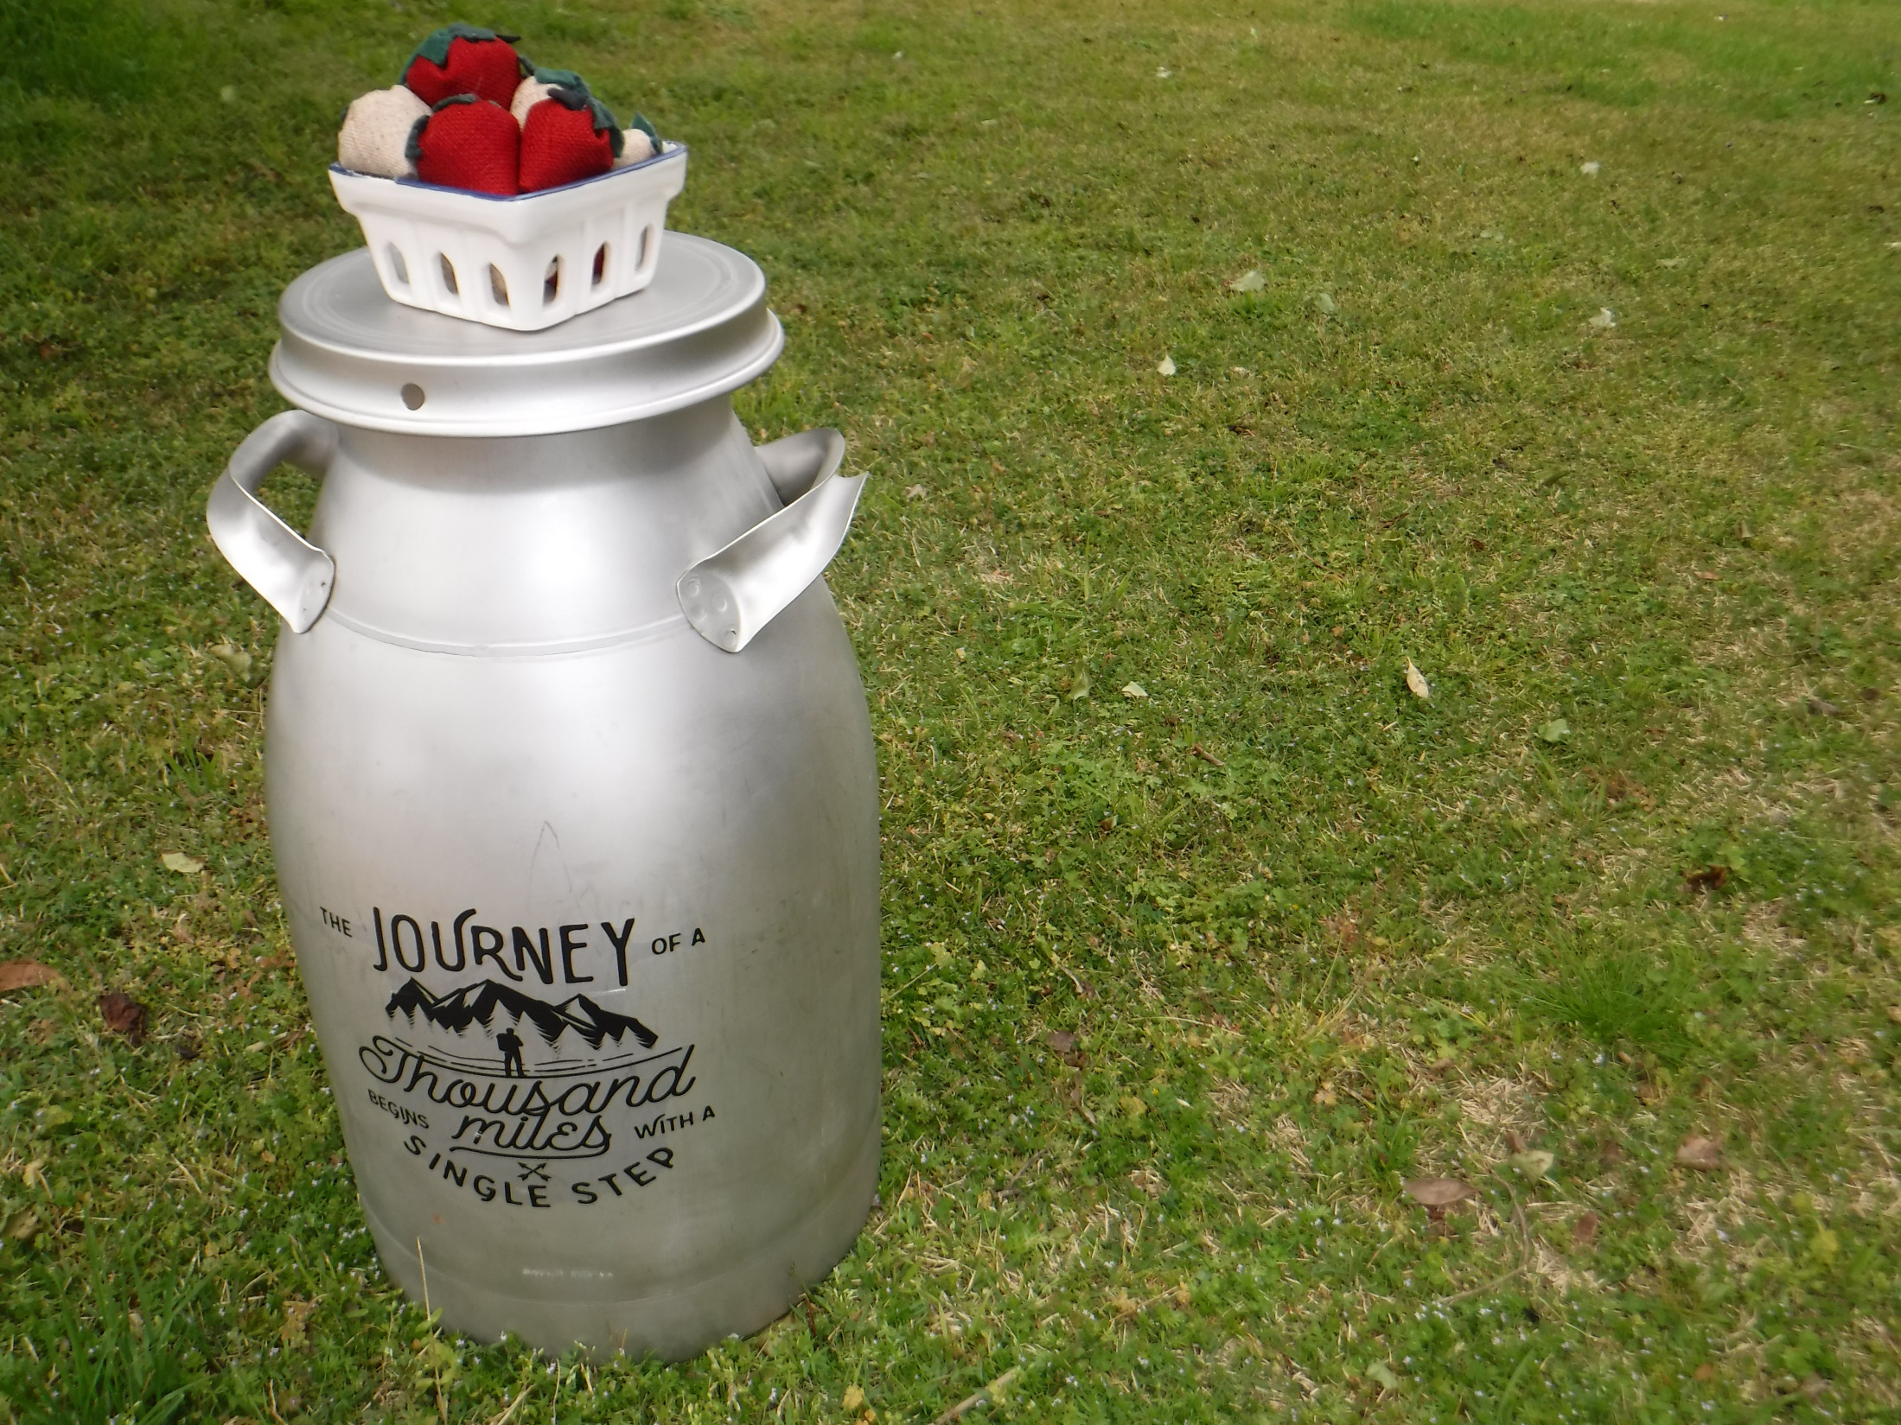
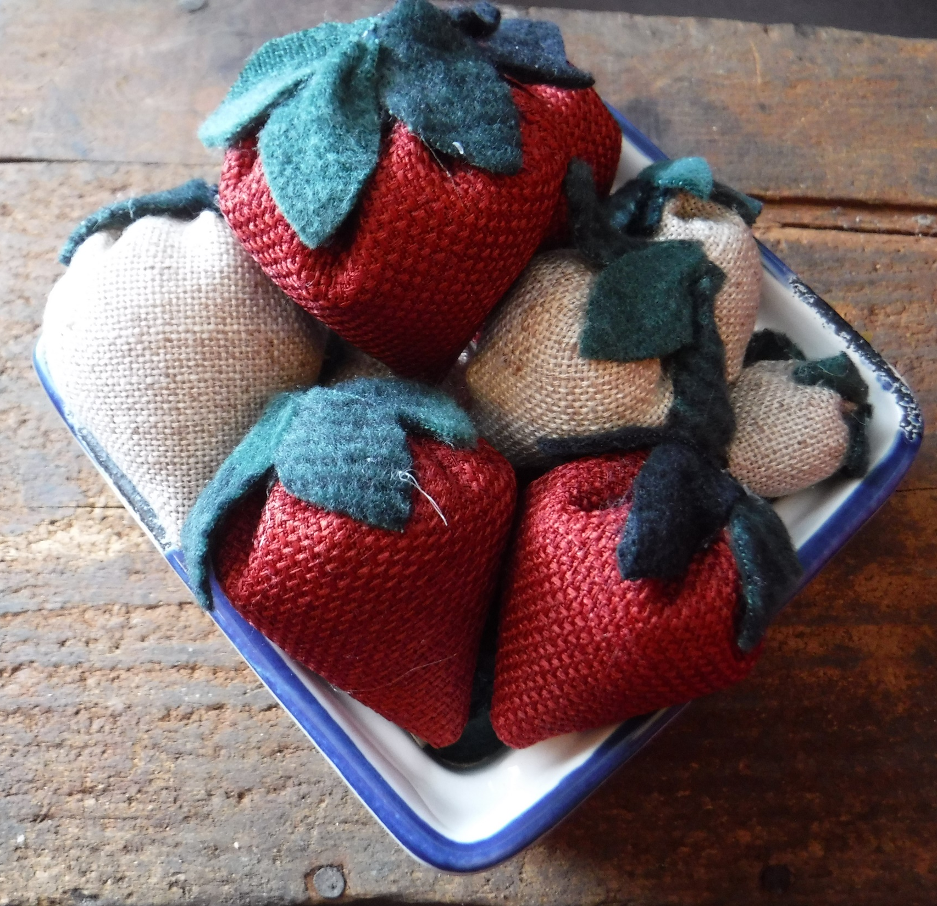
Fabric Strawberries

Slide 9
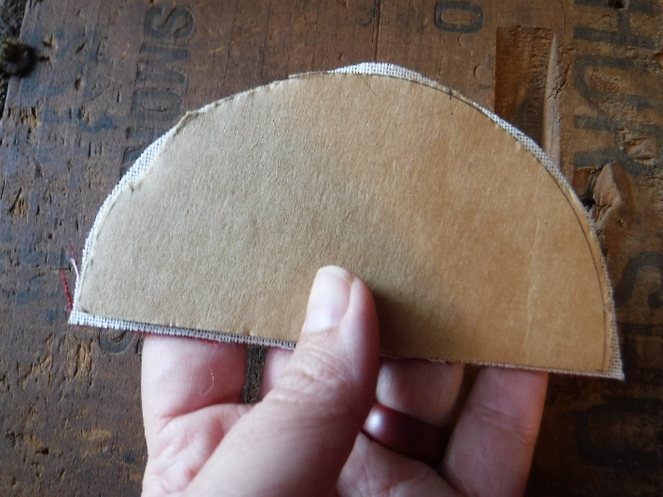
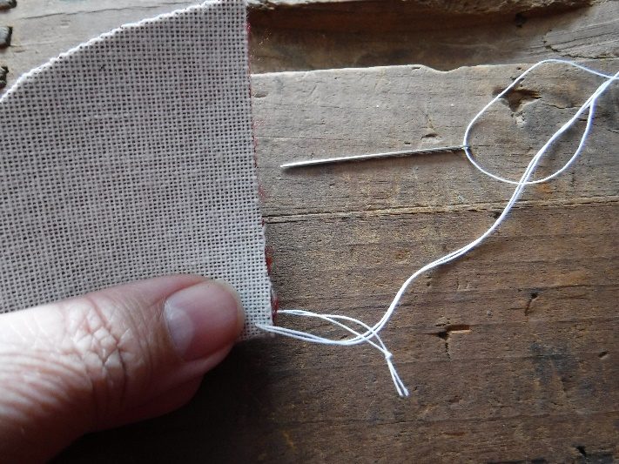
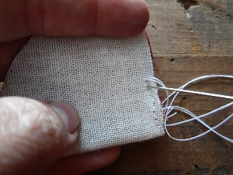
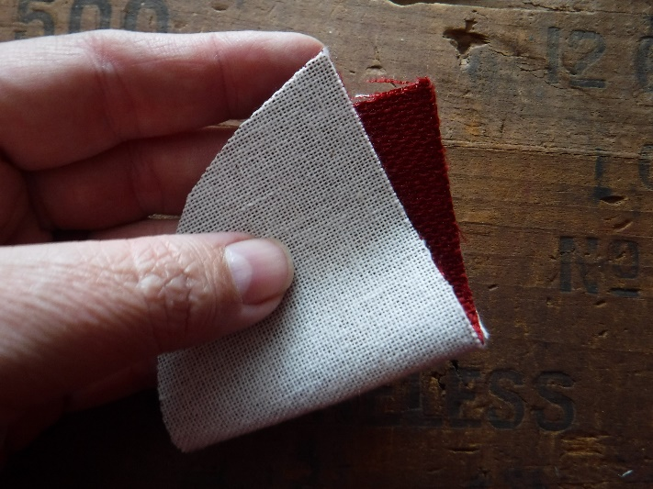
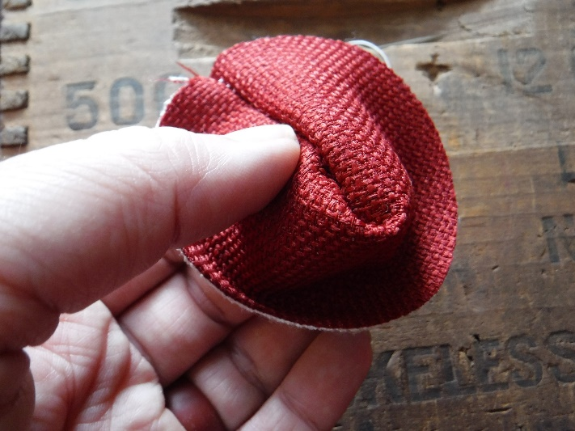
1. Cut half circle of fabric
2. Thread a needle with doubled thread and knot the end
3. Fold fabric, right-side together, on the straight edge to make a cone
4. Secure first stitch by passing needle through the double thread or with double knot
5. Stitch close stitches or with backstitch. Backstitch: needle comes up (a.) and should go down where last stitch is shown (b.)
6. Flip right-side out
a
b

Slide 10
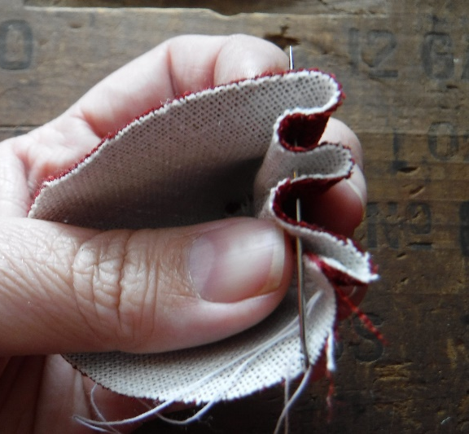
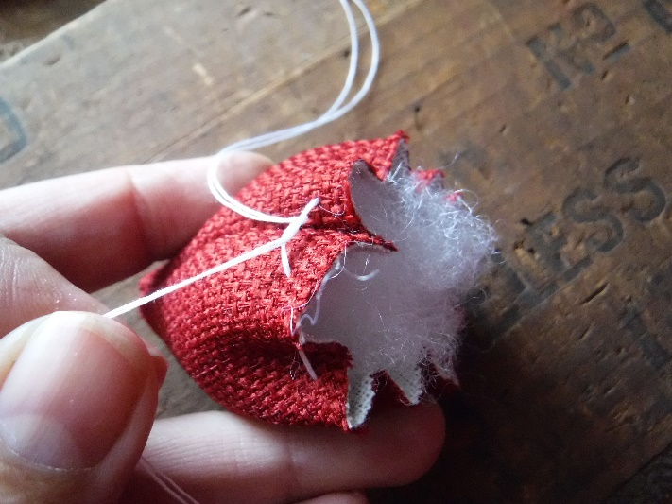
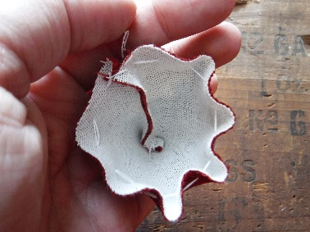
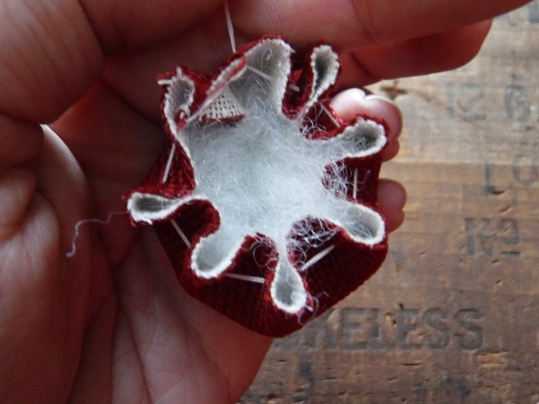
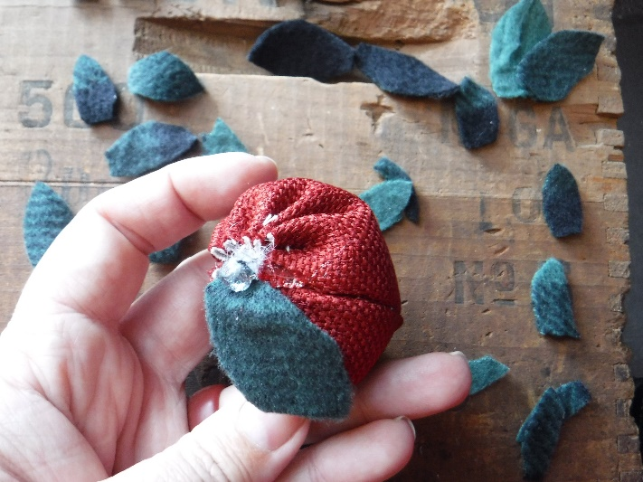
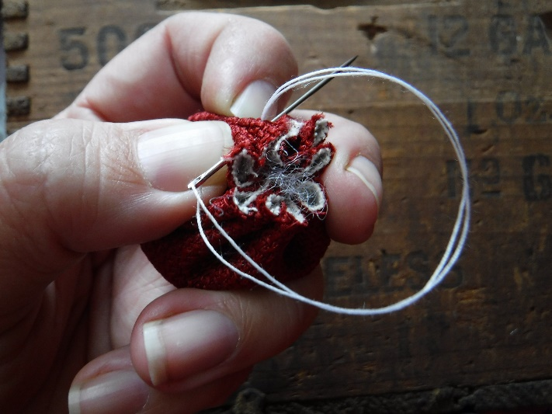
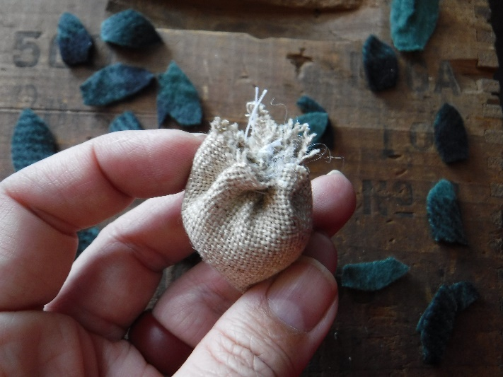
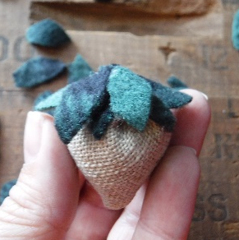
7. Starting at side seam, sew long running stitch around the circumference of opening, close to the edge
5. Fill with substrate; pull the ends to gather the circle
6. Secure with a knot (see next picture)
If working with a very green crafter, side seam thread can be tied off and secured. New thread can be strung and gathering seam with double knot
7. Glue felt or fleece leaves on top. 5 leaves works for most berries
8. Really rough berries just need more leaves

