Slide 1
Using Common Measures 2.0 to Evaluate Your Science Programming
National 4-H Council Common Measures Challenge Cohort Grant
Elizabeth Conway, 4-H Agent, Athens-Clarke County
Machelle Gill, 4-H Agent, Gilmer County
Chesley Davis, 4-H Agent, Lumpkin & Dawson Counties

Slide 2
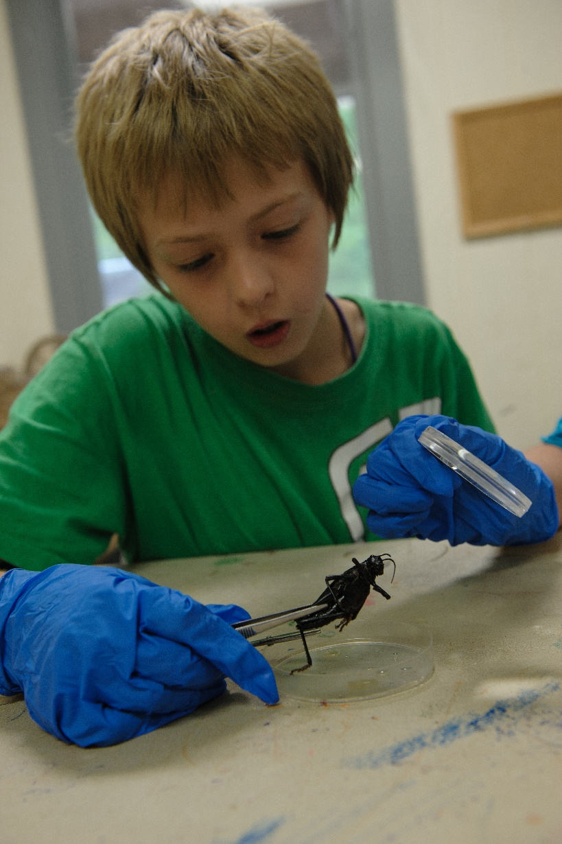
History
In 2012 4-H stakeholders collaborated to create a series of standard instruments to assess youth outcomes and indicators
4-H National Headquarters, National 4-H Council, and representatives from land-grant universities and National Mission Mandate teams
Guided by the National 4-H Logic Models, stakeholders reviewed and developed common outcomes, indicators, and items aligned with program areas in grades 4-7 and 8-12

Slide 3
Goals
Identify a common core of youth outcomes and indicators which can be used to improve programs
Provide a process for assessment and report from a national data base
Provide state 4 H programs with resources to assist them in the planning of local, state-wide and regional evaluations

Slide 4
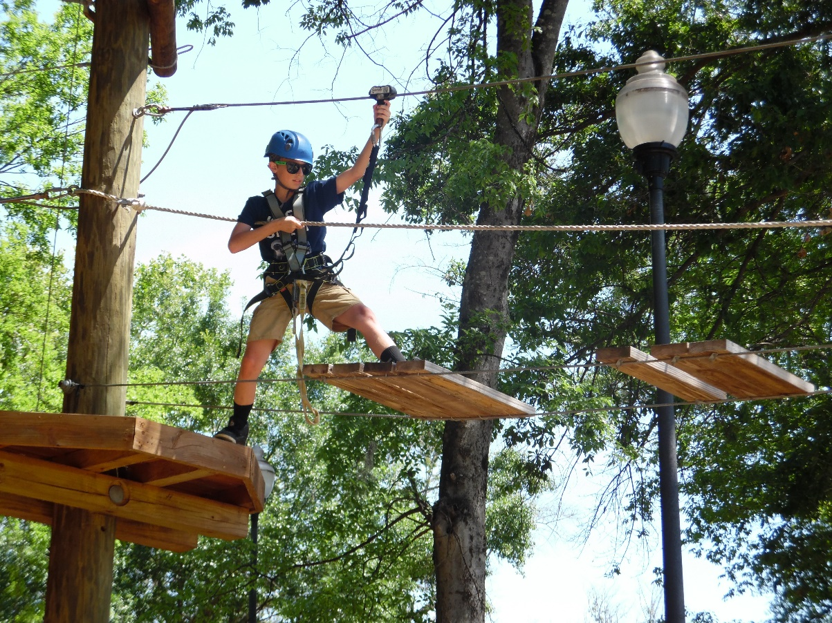
Original Common Measure Surveys
Universal (4-7)
Universal (8-12)
Citizenship (4-7)
Citizenship (8-12)
Science (4-7)
Science (8-12)
Healthy Living (4-7)
Healthy Living (8-12)
College and Career Readiness (8-12)
Demographics

Slide 5
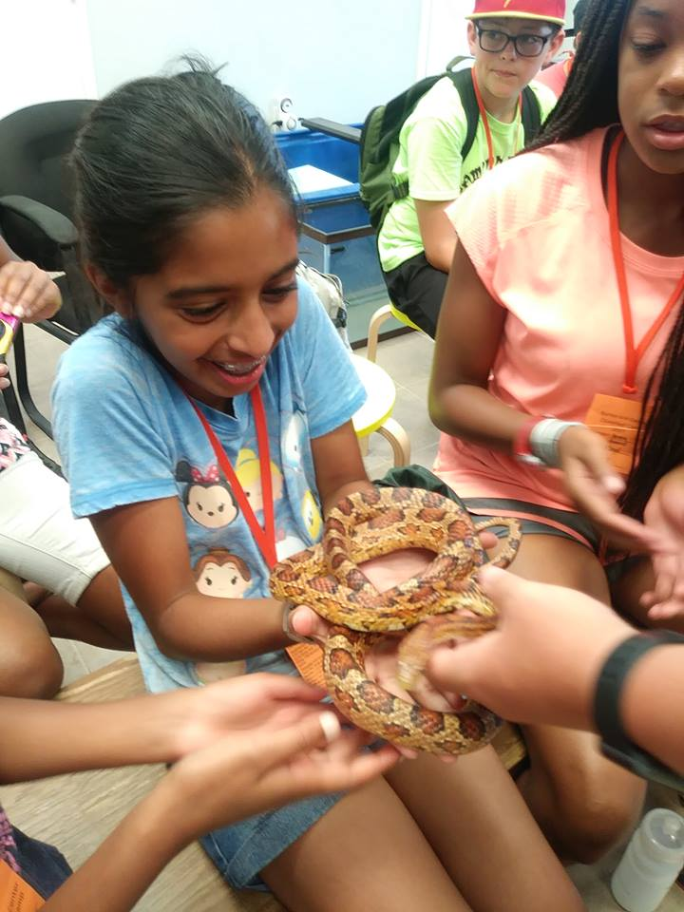
Common Measures 2.0
Review existing instruments and feedback from 4-H systems
Develop items for measuring program improvement that provide contextual understanding of the youth experience
Develop new measures for evaluating character development
Develop new measures for evaluating targeted behavioral change
Re-design the survey protocol

Slide 6
Common Measures Challenge Results
Citizenship
4-H State Council
97%
Agree 4-H Is a place where they are encouraged to plan for their future
98%
Believe 4-H is a place where you can learn about ways to help your community
94%
Say 4-H is place where you have a choice to be a leader

Slide 7
Evaluation VS Impact
Impact
Positive or Negative Difference, Measurable
Change in Knowledge, Attitude, Behavioral Belief
Making a Difference in People’s Lives
Evaluation
Pass Judgement
Acts of Digging Deeper
Tool Used to Determine if Program is Effective
Measuring Impact or Change in Attitude/Behavior Facilities-Program
Measuring Whether or Not What Was Done Made an Impact
Process to Measure Success/Failure of Identified Objectives (Logic Model-Short, Medium, Long) Plan of Work
Pass Judgement
Acts of Digging Deeper
Tool Used to Determine If Program is Effective Measuring Impact or Change in Attitude/Behavior Facilities-Program
Measuring Whether or Not What Was Done Made and Impact
Process to Measure Success/Failure of Identified Objectives (Logic Model-Short, Medium, Long)
Plan of Work

Slide 8
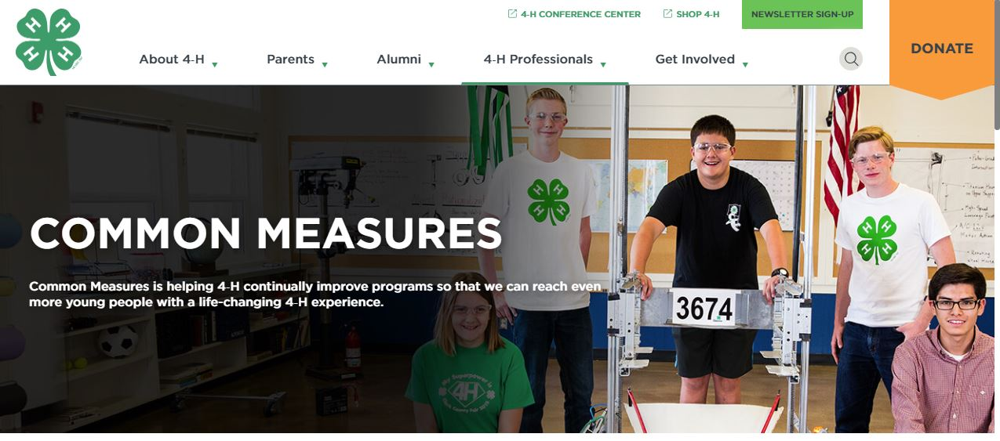
https://4-h.org/professionals/common-measures/
You will need to sign in with email address & password. Then click on Common Measures 2.0 to see survey download.

Slide 9
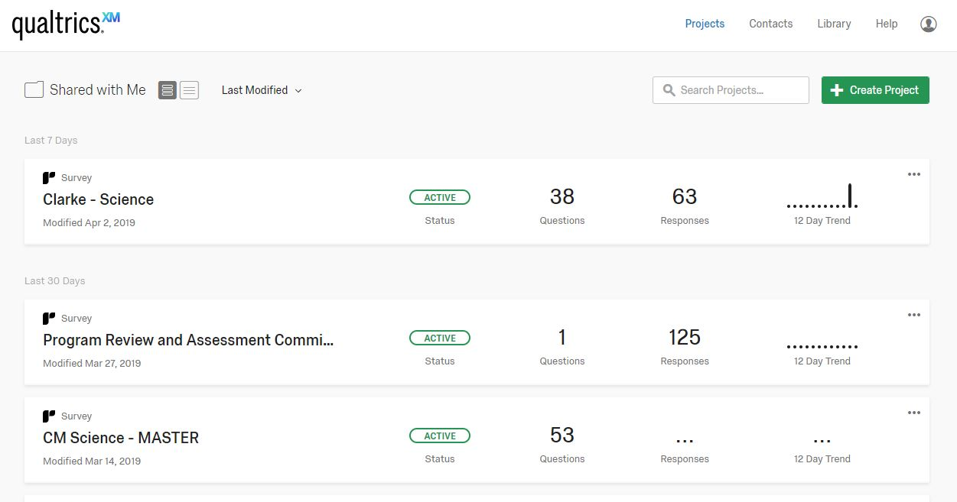
https://ugeorgia.ca1.qualtrics.com/Q/MyProjectsSection

Slide 10
Qualtrics 101
Technical Support
Contact UGA EITS Help Desk at helpdesk@uga.edu or by phone at 706-542-3106
Qualtrics Support
Phone or e-mail assistance from Qualtrics is available during their normal business hours, 9:00am - 8:00pm Eastern Standard Time Monday-Friday (except holidays). Qualtrics will respond to support request calls or e-mails based on the order by which they are received.
Telephone (Toll Free): 1-800-340-9194
Email: support@qualtrics.com
Online Training
Extensive online training material is available at Qualtrics Survey University.
https://www.qualtrics.com/support/
YouTube Videos: https://www.youtube.com/user/QualtricsSoftware
The training material will help you to master Qualtrics in minimum time.
A number of pre-recorded training sessions, as well as additional resources (such as "Free eBooks" and "Research Helps") can be accessed at this site.

Slide 11
What Outcomes Do You Want To
Measure For You Programs??????

