Slide 1
What is Experiential Learning?
Dr. Eric D. RUbenstein

Slide 2
Objectives
Define experiential learning.
Think of experiential learning in terms of your own experiences.
Discuss how people learn.

Slide 3
What is experiential learning?
Experiential learning is the sense-making process of active engagement between the inner world of the person and the outer world of the environment.
Beard & Wilson (2006)

Slide 4
The Learning Cycle
Experience:
Initial or Experimentation
Initial Focus
Next Iteration of Cycle
Generalization
Reflection
(Roberts, 2006)

Slide 5
Transforming Experiences

Slide 6
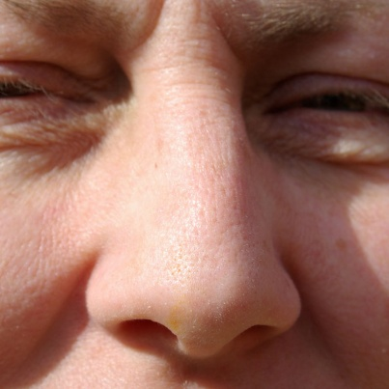
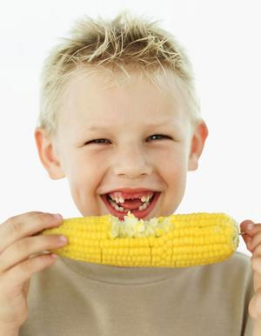
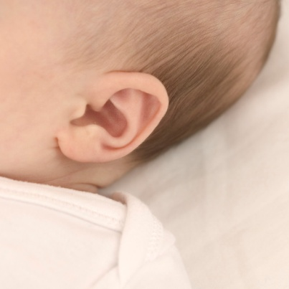
So how do we input information from the outside world?

Slide 7
Information Processing Model of Cognition
Input
Sensory Input
Working Memory
(Short Term)
Long Term Memory
Experiential Processes
“External”
Cognitive (Mental) Processes “Internal”
Experience
Reflection & Generalization

Slide 8
Cognitive Schema
New Knowledge
How does it relate?
Existing Knowledge

Slide 9
David Kolb
Concrete Experience
Grasping via
Apprehension
Active Experimentation
Transformation
via Extension
Transformation
Via Intention
Reflective Observation
Grasping via
Comprehension
Abstract Conceptualization
© 1984. Reprinted with the permission of Pearson Education, INC. Upper Saddle River, NJ.

Slide 10
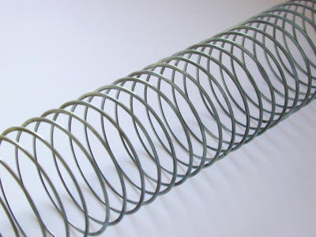
The Continuous Learning Cycle

Slide 11
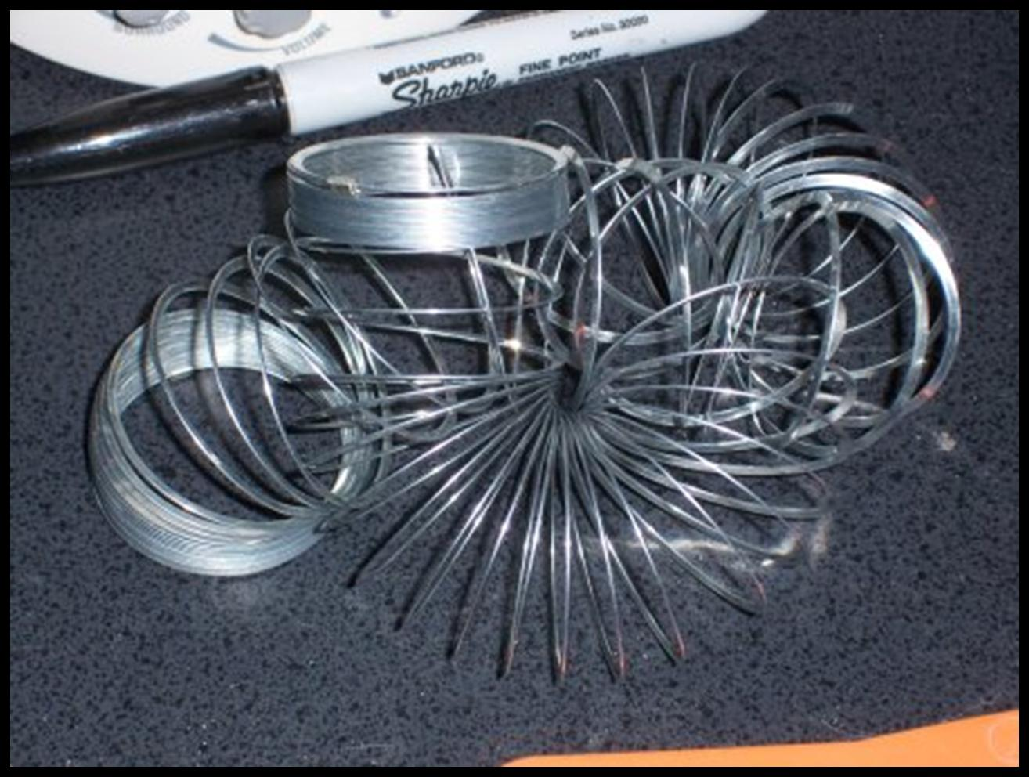
Learning isn’t always easy!

Slide 12
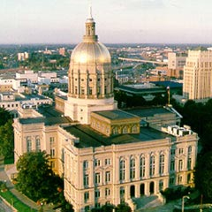
Questions/Concerns
In groups (by grade levels/schools)
How do you assess student learning in your classroom?
What concerns do you have when assessing students?
How do you use the data you collect?

Slide 13
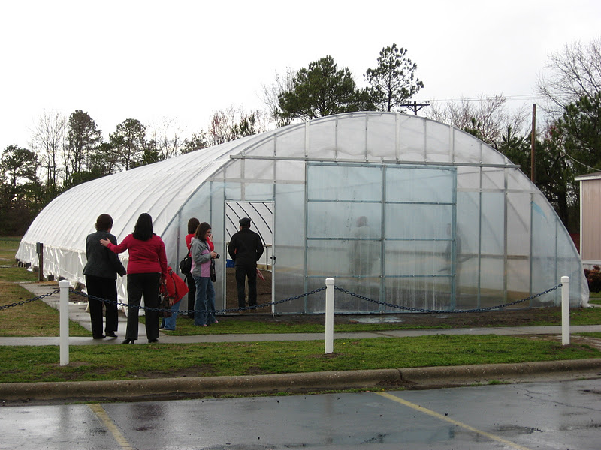
Vee Maps: History
Created and introduced to student scientific laboratories (Novak and Gowin, 1984)
Highlight the interrelationship of concepts and methods with knowledge construction or analysis
Promotes inquiry through student investigation
Vee maps promote student inquiry at the analysis, synthesis, and evaluation levels

Slide 14
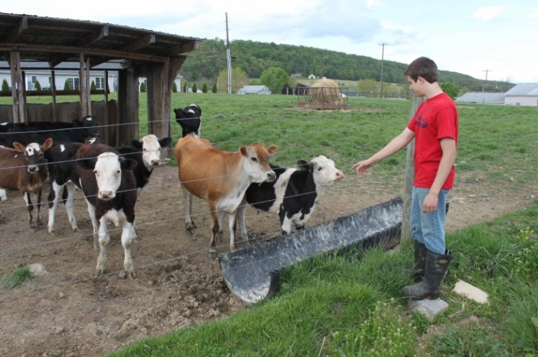
Vee Map
Inquiry Question
Word List
Concept Map or Graphic Organizer
Hypothesis
Steps
Data (In Table, Chart, or Graph form)
Conclusions

Slide 15
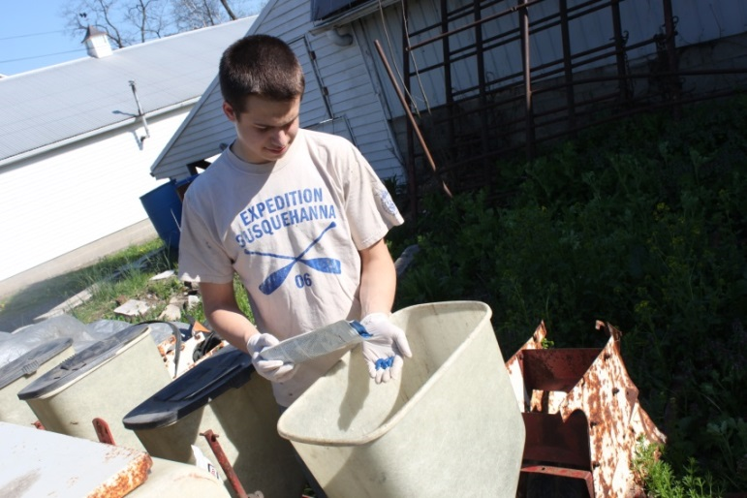
Inquiry Question
Student Developed vs. Teacher Developed
Guides research to be conducted
Methods utilized and data collection
Question form
Example: What influence does light have on seed germination?

Slide 16
Word List
Collection of terms
New
Previously learned
Related to investigation being conducted
Challenge students

Slide 17
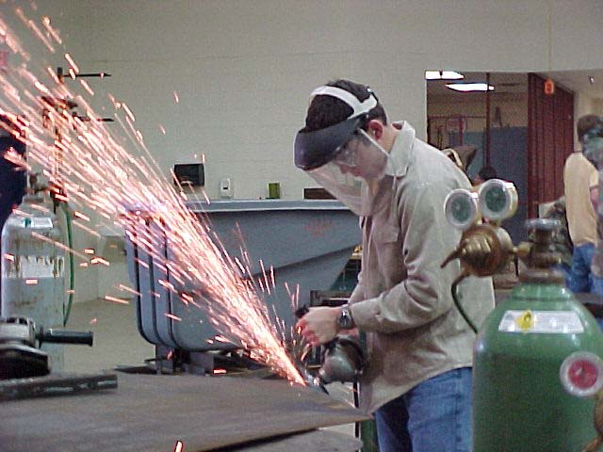
Concept Map
Graphic representation of knowledge/thoughts
How do you visualize your thoughts?
What do you believe about the concept being investigated?

Slide 18
Hypothesis
What do you believe the outcome will be?
Written in statement form – Not if/then statement
Formed by students

Slide 19
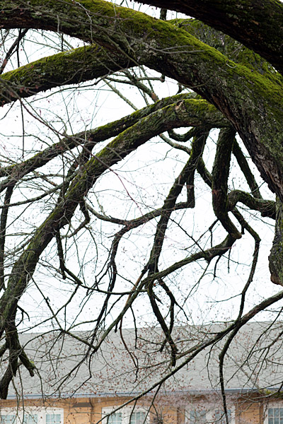
Steps
What did the students do?
Similar to methods
Steps to complete the investigation
Provide detail to what happened
Sentence form not bullets
Present tense not past

Slide 20
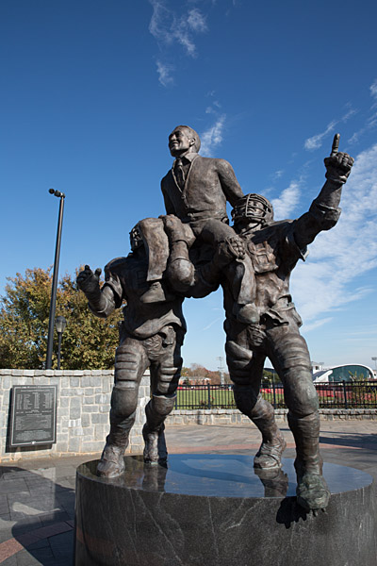
Data
Quantitative and Qualitative Data
Graph/chart/table form
Easy to ready
Include each variable and the data collected
Developed prior to the investigation being conducted

Slide 21
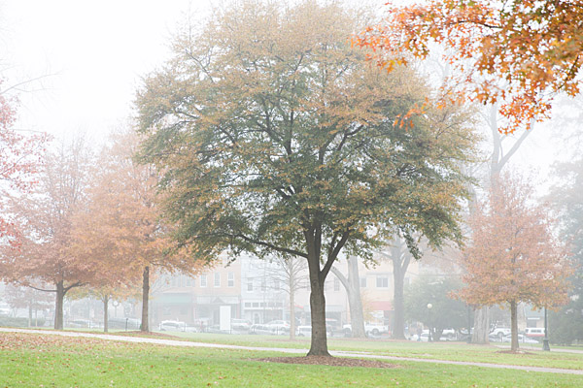
Conclusion
What does everything collected mean?
What implications does this have on society?
What should be changed to improve the study next time?
What other studies should be conducted?

Slide 22
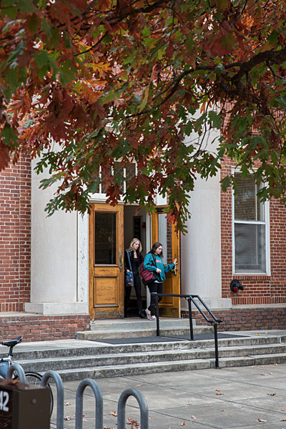
Try on our own
Using the provided example investigation
Complete the Vee Map
Follow the flow of the graphic
Do not jump ahead
Ask questions as you have them

Slide 23
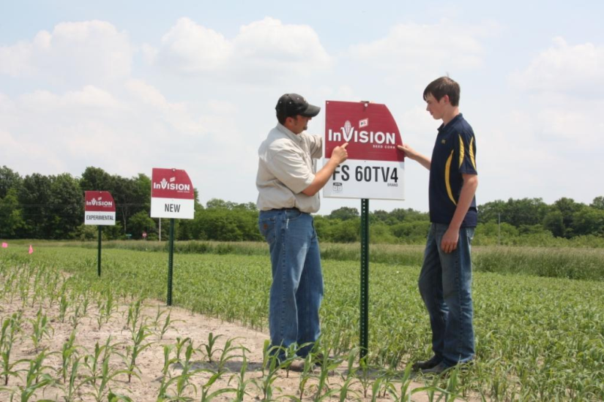
What does this look like?
In groups according to grade level
Discuss what does this look like for your students?
Can they use the exact document that was demonstrated today?
What alterations need to be made to make this successful?

