Slide 1
Community Partnerships
Tell us who you are connecting with!

Slide 2
Hello again!
Please create a new slide and follow the directions to the right.
After examining the UGA Cooperative Extension Website:
Remind us who you are (school, grade, etc.)
Who you would like to connect with
1-3 ways you plan to work together
Have fun – this board may be a great way to share or brainstorm ideas. Maybe you can connect with another teacher who wants to work on a similar project, too!

Slide 3
Hi, my name is…
And I teach…
Program I would like to work with:
Ideas for collaboration:

Slide 4
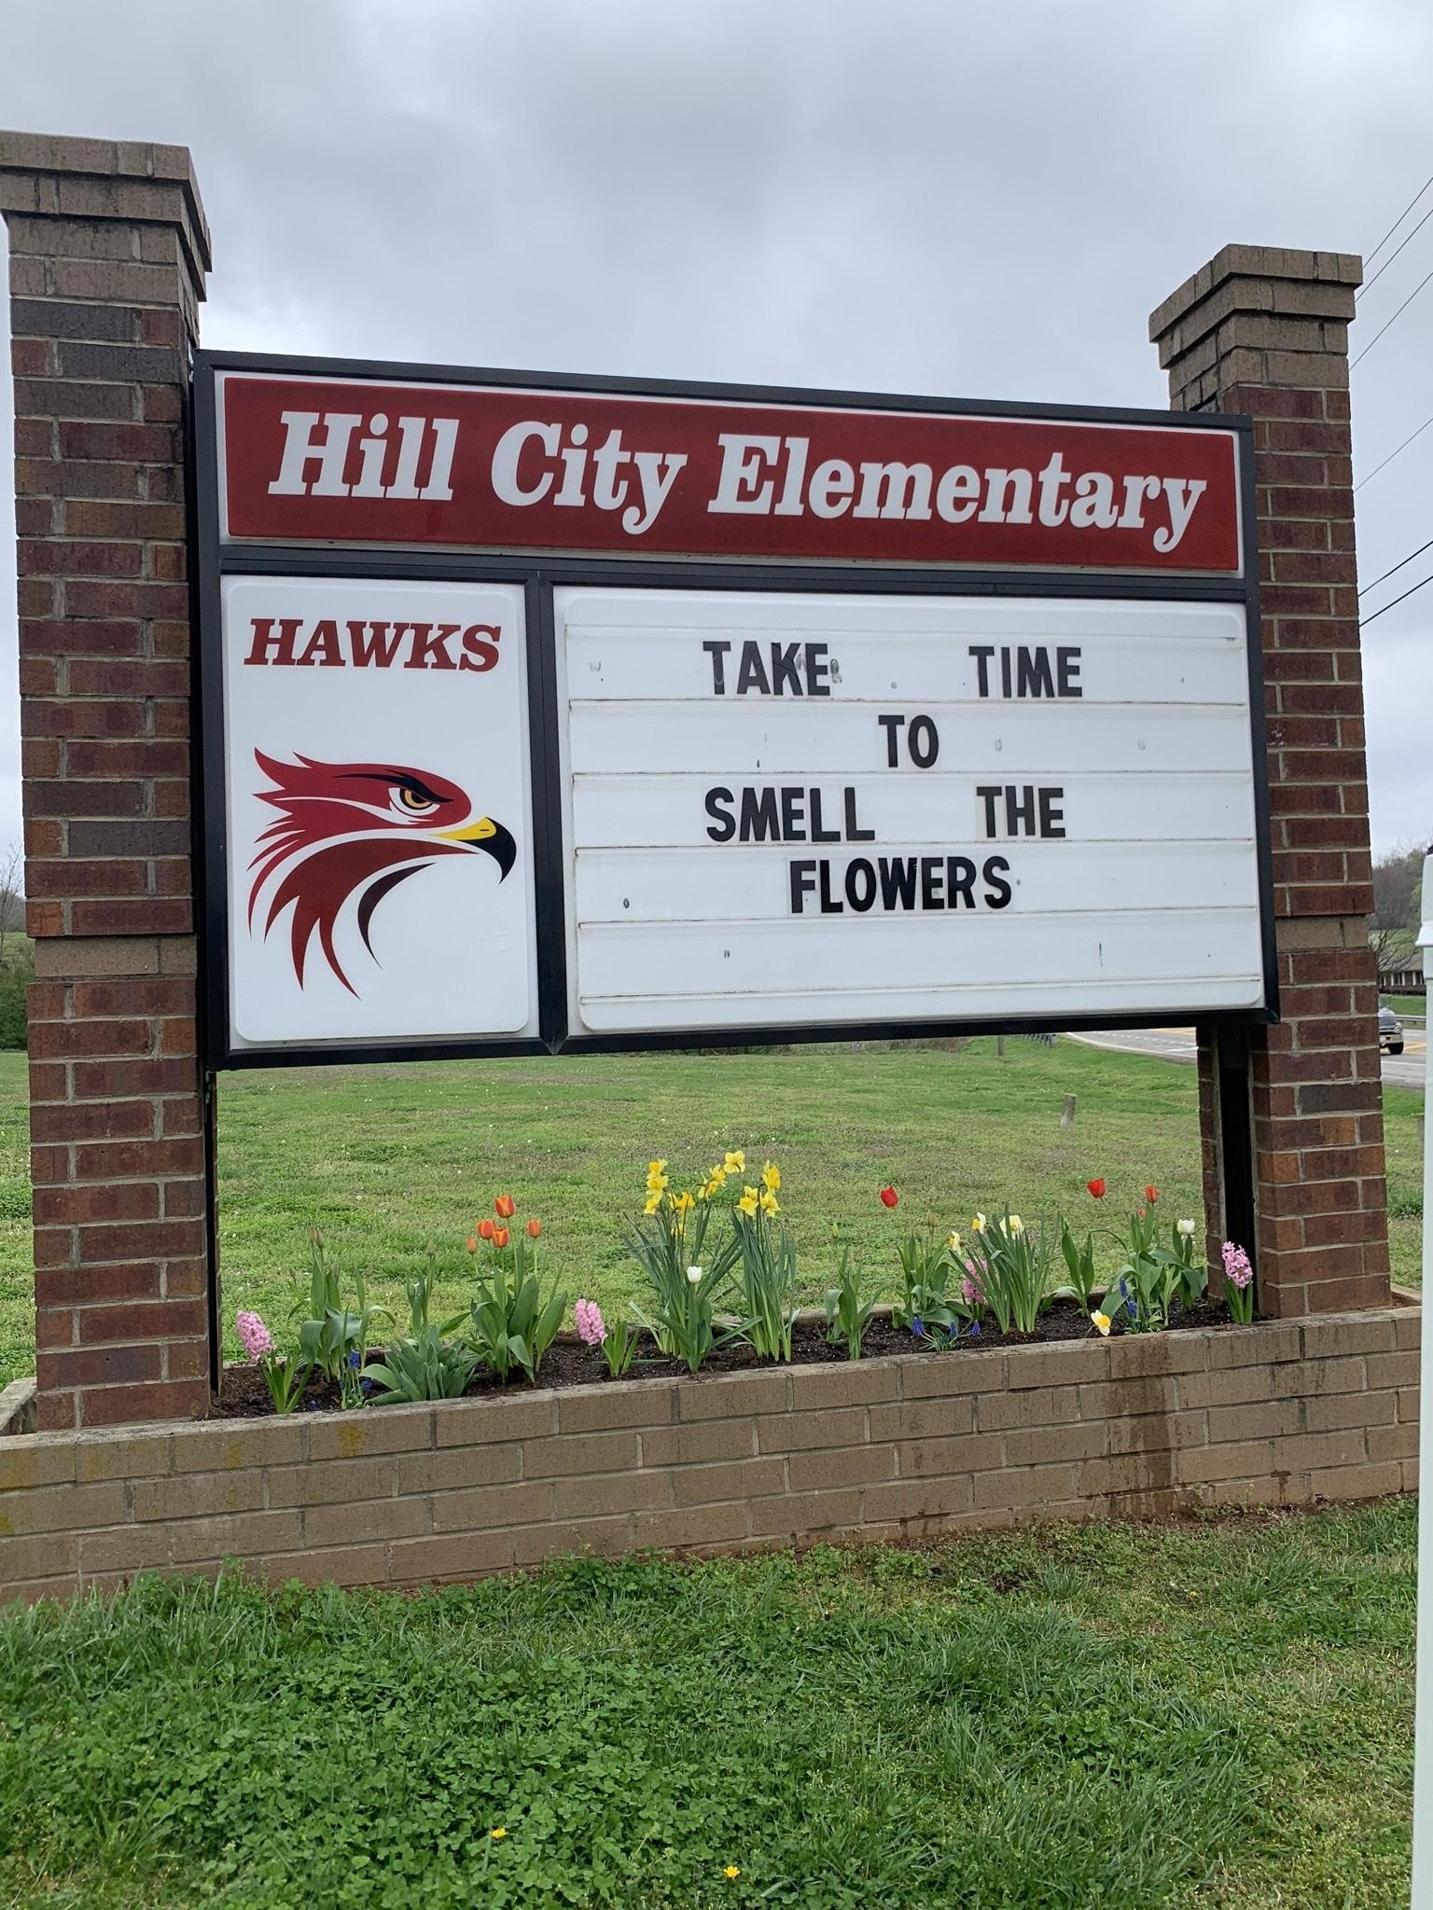
Hi, my name is…
Sonia Chapman
I teach at Hill City Elementary in Pickens County. We have a K-4 program. I see all my students one day a week during our camp rotations. We are honored to be part of the elementary pilot program.
I would like to build a relationship with our local extension agent to start a 4th grade 4-H program.
I also want to reach out to our middle school and high school programs about partnering with our students to help with planting and weeding our raised beds and garden.

Slide 5
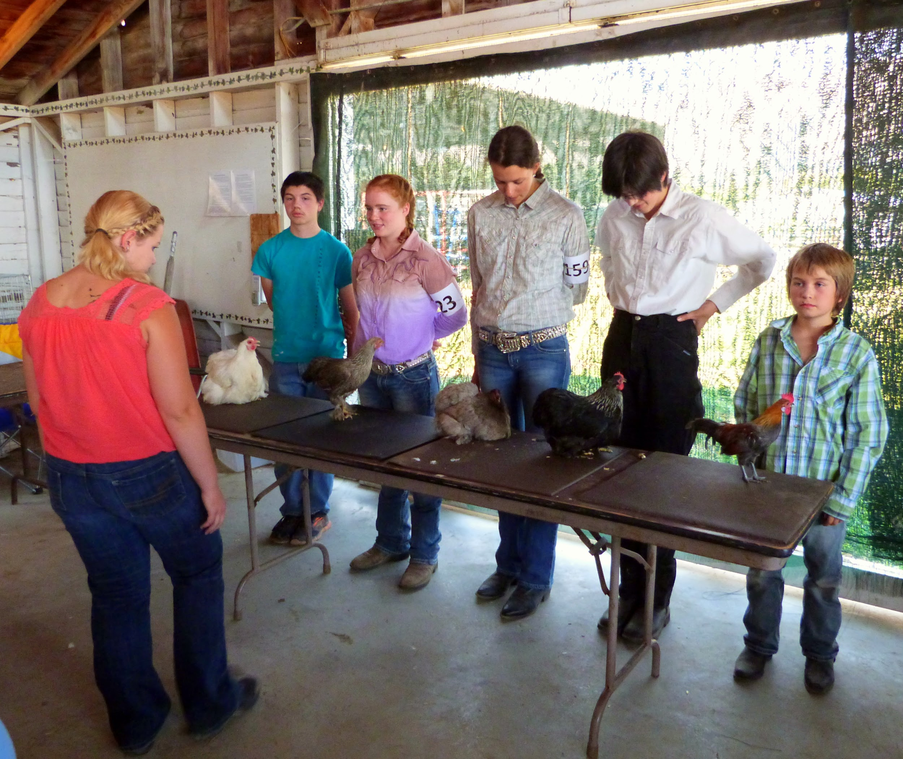
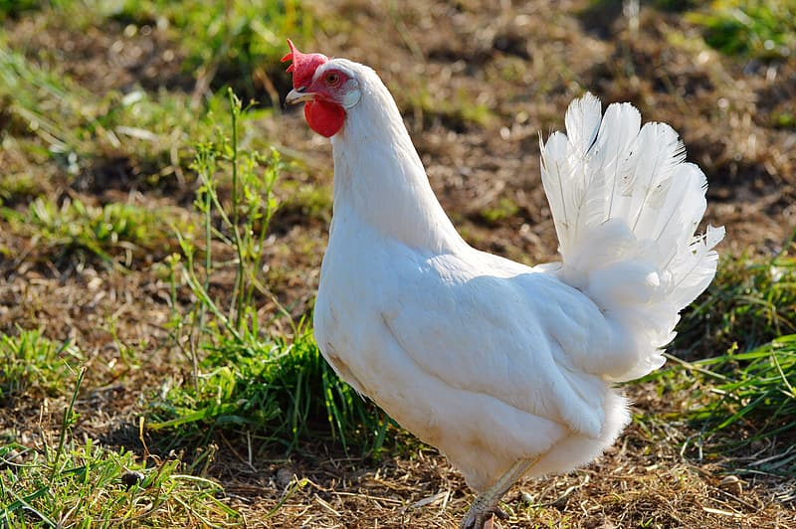
Stephanie Peterson
Westside Elementary K-5, 960+ students
I plan on connecting with Lowndes County 4-H!
Scheduling community service days with middle and high school 4-Hers to help the elementary students weed the garden and plant flowers in the spring. This will give Junior and Senior 4-Hers leadership activities for their portfolio.
Encouraging 4th and 5th grade 4-Hers to participate in Perry Fair mini booth and artifact exhibits in early fall. Have afterschool work sessions where extension agent comes to give directions and ideas. Have 4-H staff deliver projects to the fair.
Encourage 4-Hers to participate in Poultry Judging, summer Camp, and County Council events. Practice poultry judging as part of my lesson plans for 5th grade (candling, labeling meat cuts, comparing eggs.
Invite 4-H agent as guest speaker directly related to Poultry Judging.

Slide 6
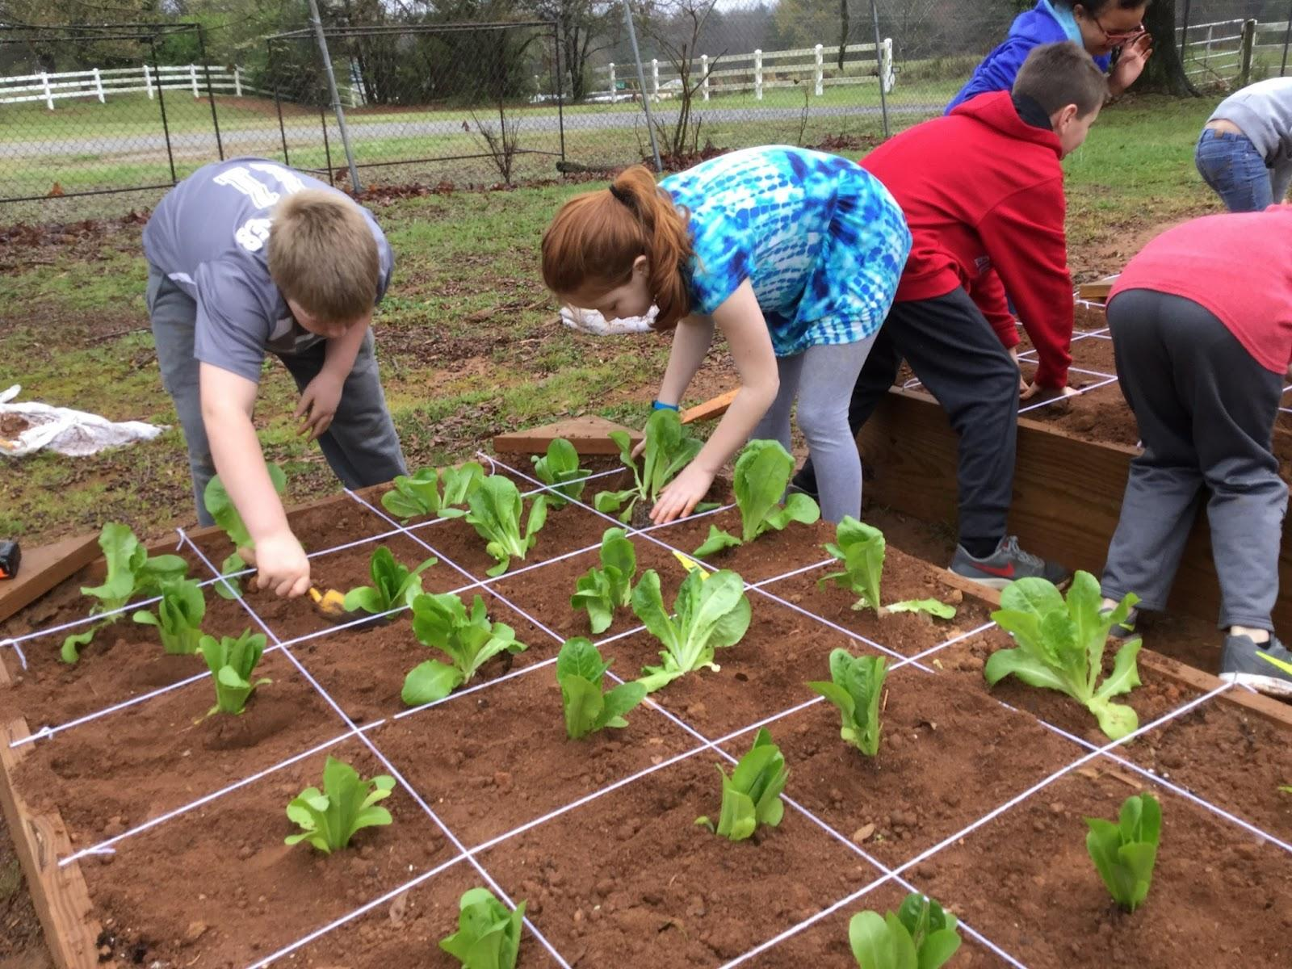
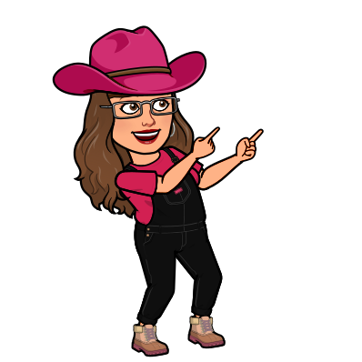
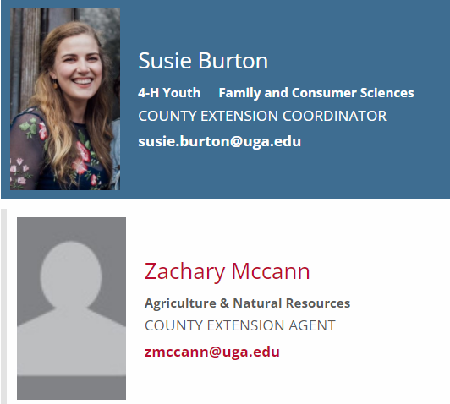
My name is Wendy Fuschetti. I work at Banks County Elementary School. We are excited to have the opportunity to grow our program. Through this pilot program, we have already invited the 4-H representatives into our Ag Lab. Our fourth and fifth graders have already have been enjoying these lessons for several years now. Susie Burton has provided resources for my students, as well as grant information. :)
I also plan to contact Zachary McCann, our county extension agent. We will continue to monitor our soil composition to maintain healthy raised beds. We will also work with Zach to plant our small blueberry patch this year. Zach has also helped us prepare our raised beds for seasonal planting.

Slide 7
Justin McDowell
Hamilton Elementary K-5
I am connecting with Colquitt County 4-H.
We have had 4-H come to the school for years and work with our 5th grade students on a monthly schedule, but this year we are starting to incorporate the program with our 4th grade students as well during my 4th grade agriculture block. This will allow us to introduce those students to DPA which they have not had the opportunity in the past. We will also look at incorporating more agriculture specific lessons in conjunction with Farm Bureau and our local Ag in the classroom coordinator, Greta Collins, working with our 4-H agent Valerie Bennett. The lesson possibilities are endless, but will possibly include information on Animal Care and shows, poultry judging, DPA, egg grading, and soil sampling.

