Slide 1
Finding your way to Junior Project Achievement
7 Steps that will get you to the district competition at Rock Eagle in March

Slide 2
Where do I list activities in my Portfolio?
Stick example activity under section of portfolio where you think would fit
Good brainstorming activity for 4-H’ers to see process
Can also use post-it notes instead of preprinted activities
Gets 4-H’ers moving and actively thinking about process

Slide 3
The road to Project Achievement
Select a project area from list
Prepare and submit a portfolio
Narrow down subject matter from project category for presentation
Research and prepare speech
Decide upon visuals
Practice

Slide 4
Project Achievement basics
Juniors are judged on two elements – presentation 60% and portfolio 40%
Portfolios are scored separately from the presentation
Portfolios can contain activities that are not specifically related to your speech topic

Slide 5
Step # 1
Select a project area – refer to the project list: http://ugaextension.org/content/dam/extension-county-offices/clarke-county/4-h/2017-jr-project-list.pdf
Most require an informative speech
Exception:
Food Labs
Performing Arts
Fashion Revue

Slide 6
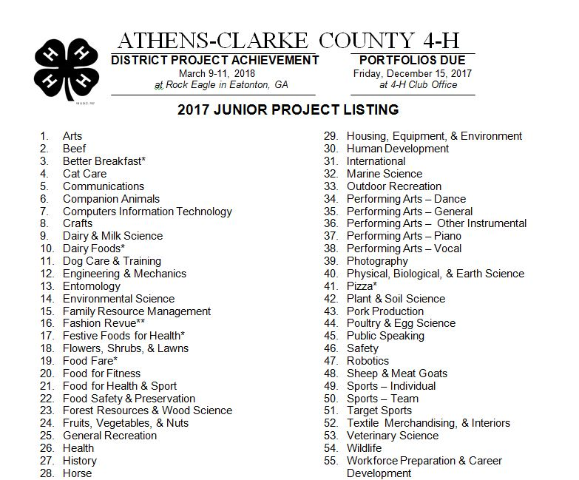
Project List

Slide 7
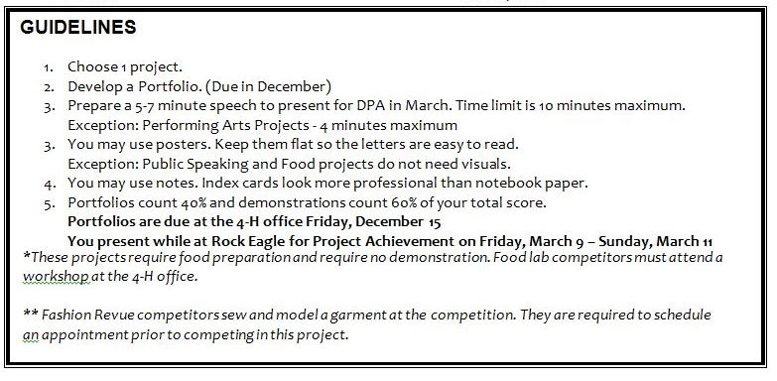
Guideline Listed at Bottom of Project List

Slide 8
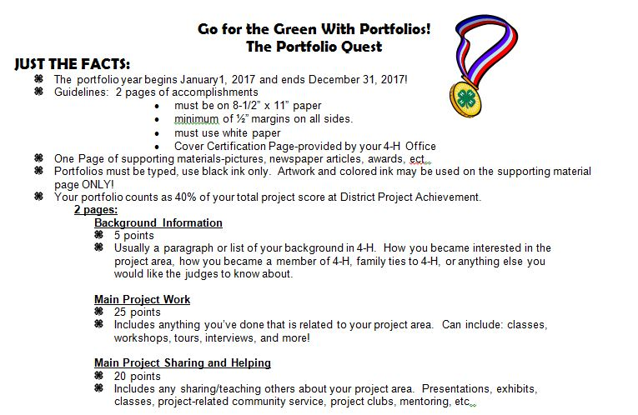
Portfolio Handout

Slide 9
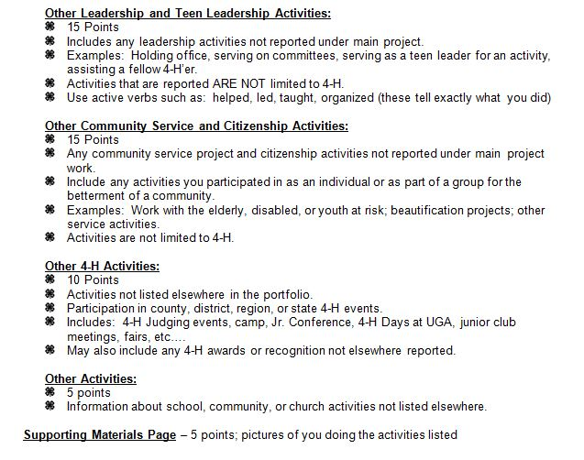
Portfolio Handout (cont.)

Slide 10
Step # 2
It’s time to work on the portfolio!
The next slides will guide you through the requirements of the portfolio

Slide 11
What is a portfolio
A document that lists the activities in which you have participated for the calendar year
Most of the portfolio is a bulleted list
There are specific categories to use
One page of supporting materials which are pictures showing you involved in the activities that you list

Slide 12
Portfolio basics
Portfolio is four pages:
cover
two typed pages of accomplishments
one page of supporting materials
Portfolios must be typed on white paper
Margins must be at least ½ inch, font should be 10 point or larger

Slide 13
Sections of the Portfolio
Cover
Background Information
Main Project Work
Main Project Sharing and Helping
Leadership
Citizenship
Other Activities
Supporting Materials
Contained on two pages

Slide 14
Portfolio Cover
Cover page contains your name and basic information such as age, grade, etc.
The 4-H office will provide you with the cover page for your portfolio
4-H’er and parent sign the cover page

Slide 15
Background Information
Usually in paragraph form
Your introduction of yourself to the portfolio judge
May include info about you, your family, reasons for joining 4-H
How you became interested in your project

Slide 16
Main Project Work
Work that you have done related to your project area
Learning experiences in project
Classes, workshops, tours, etc.
List books, videos, or TV shows that relate to area
Can include school classes

Slide 17
Main Project Sharing and Helping
Includes sharing/helping others in your project area
May include:
Classes taught
Presentations
Exhibits
Project related community service

Slide 18
Leadership
Any leadership activities not included in main project area
Holding office, serving on committees, etc.
Activities are NOT limited to 4-H
Use verbs such as: helped, led, organized, or taught to tell what you did

Slide 19
Citizenship
Any community service activities not listed under main project
Activities to assist an individual or group
Activities which will improve the community
Not limited to 4-H

Slide 20
Other 4-H Activities
Anything else that you have done in 4-H not already listed in portfolio
Can include judging teams, summer camp, contests, reward trips, etc.
In school 4-H club meetings
Portfolio workshops

Slide 21
Other Activities
Anything else you have done not listed elsewhere in the portfolio.
Can include:
School clubs, events
Awards, honors
Church activities
Youth groups such as scouting
Sports teams

Slide 22
Supporting Materials
Pictures or articles which document the activities listed in the portfolio
Photos may be staged such as:
Feeding or walking dog (category dog care)
Setting table or cooking, grocery shopping, clipping coupons, etc. (food category)

Slide 23
Portfolio Due Date
Note the published deadline for portfolios to be turned in to the Athens-Clarke County 4-H office. It will usually be the last day of school before Christmas break.
Don’t wait till the last minute. Let’s get started today!

Slide 24
Step # 3
Time to turn your attention to your project/presentation

Slide 25
After the Portfolio is submitted
Narrow your subject within your category
Research/gather information to write your speech

Slide 26
A Good Speech contains:
Introduction – Hook the audience, introduce yourself, tell them what your speech will cover
Body – The facts that you want to tell the audience about your subject
Conclusion – Summarize your main points, refer back to your opening hook, leave your audience wanting to hear more or take action

Slide 27
Time requirements
A junior presentation should be 7-9 minutes in length
Exceptions:
Performing arts – 4 minutes
Food labs – have specific time limits for each project
Fashion Revue – model garment that you have made and answer questions

Slide 28
Step # 4 – Visual Aids
A visual aid is something your audience can see which helps them understand your subject. Examples:
Posters
Pictures
Items
Showing how to do something

Slide 29
Poster Pointers
Big and simple is best. Words should be read from the back of room
Main ideas or phrases
Use plain, easy to read type
Dark colors for type, light colors for background

Slide 30
Step # 5 - Practice
Know your material and make sure you can pronounce all words
Speak clearly and distinctly
Stand tall and straight
Make eye contact with audience
Use or interact with your visuals

Slide 31
Step # 6
Make an appointment and come to the 4-H office
Give your speech to one of the 4-H staff
Make any changes that are recommended

Slide 32
Step # 7
Pack your bags!
You’re on your way for a weekend of competition and fun 4-H activities at Rock Eagle
Northeast District Project Achievement is usually in March (check with ACC 4-H office to confirm date)

Slide 34
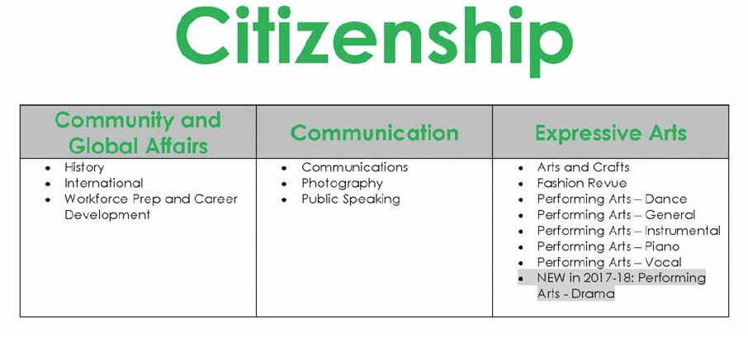
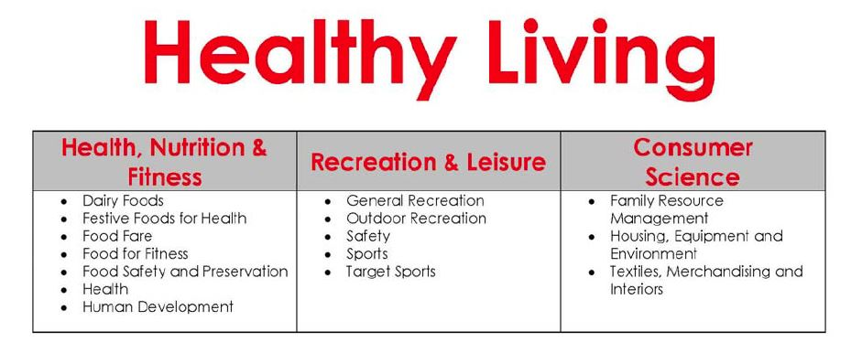

Slide 35
Project Changes

Slide 36
Portfolio Examples
Portfolios of previous State Congress winners available to review in room
Idea Sharing and Questions?

